Slide 1
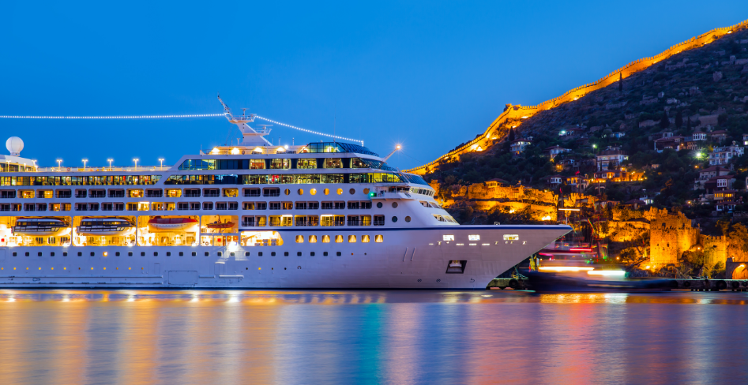

AUDIÊNCIA PÚBLICA
Comissão de Viação e Transportes – CVT
24.08.2016

Slide 2

AGENDA
- Números no Mundo
- Números no Brasil
Panel Discussion
Cruise Industry Marketplace
- Impacto do Custo de Praticagem
Notes:
LORRI CHRISTOU
Welcome to the 2015 Cruise State of the Industry Press Conference and Media Marketplace.
We are always happy to be here to speak with our key media and member partners.
For those who I haven’t had the opportunity to meet, I’m Lorri Christou and joined CLIA late last year as SVP, Strategic Marketing and Communications.
We have a very exciting and informative agenda for you today.
CLIA’s new Chairman Adam Goldstein, President and Chief Operating Officer of Royal Caribbean Cruises Ltd., is here today to share with you the State of the Cruise Industry. Adam began his role as CLIA’s Chairman on January 1 after Howard Frank stepped down as part of our normal rotation. We are very honored that Adam is able to join us today.
Next, Maria Miller, SVP, Marketing, Norwegian Cruse Line, will present the 2015 Cruise Industry Outlook, focused on passenger data, new ships, destinations and trends.
We’ve added a new and engaging panel discussion to our agenda. I’m looking forward to moderating a discussion of key cruise executives who will share their cruise lines’ efforts to attract more passengers.
Afterwards, you are all welcome to join us for our cruise industry marketplace where we have representation from 20 CLIA member cruise line partners and CLIA executive partners including the Hong Kong Tourism Board, Port Everglades and Intercruises Shoreside and Port Services. We are always excited that our global partners are able to join us for this event, and on behalf of CLIA, I would like to welcome CroisiEurope as our newest Global cruise line member. CroisiEurope is Europe’s largest river cruise line with a fleet of 30 ships. The line’s new Loire Princesse will debut April 2015.
And, of course, we hope you enjoy the great food and wonderful venue.
To kick us off, I’d like to introduce Cindy D’Aoust, CLIA’s Executive Vice President, Membership and Operations. In this role, she is responsible for the newly launched travel agent and agency membership programs as well as CLIA’s Executive Partner program. D’Aoust has also assumed day-to-day management for CLIA’s U.S.-based operations in Washington, DC, and Fort Lauderdale, FL, while CLIA conducts the search for a new President and CEO. The position left vacant by Christine Duffy who is leaving CLIA to join Carnival Cruise Line as their new president.
D’Aoust is a recognized leader in the meetings and travel industry, and has worked in the industry for more than 20 years. Prior to joining CLIA, D’Aoust served as Chief Operating Officer at Meeting Professionals International (MPI), the largest global meeting planning association in the industry. In that role, she was responsible for global operations, marketing and member deliverables.
Please welcome Cindy D’Aoust.
CINDY D’AOUST
I am excited to be here and look forward to continuing all the great work in progress at CLIA from our new travel agent, agency membership and executive partner programs to our work on the technical and regulatory front. I also look forward to speaking with many of you today.
At this time, it is my pleasure to introduce Adam Goldstein.

Slide 3
EVOLUÇÃO EM NÚMERO DE PASSAGEIROS
2014
22,1
2015 23,2
2016 24,2
2017 25,2
2018 26,2
2019 27,3
Em Milhões
Notes:
Data tells us that we are meeting this goal.
CLIA member global ocean cruise passenger volume is projected to increase almost 26% between 2009 and 2014 with an average growth rate of 5%.
Projected CLIA Ocean Cruise Passenger number was 21.7 million in January 2014. After three quarters of 2014 reported, we have increased our 2014 passenger number to 22.1 million - 400,000 above our original projection.
Passenger growth of 800,000 from 2013 to 2014.
Maria will be sharing our 2015 projection soon.

Slide 4


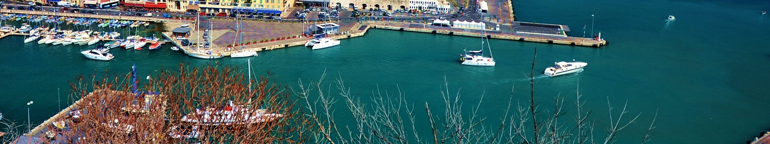
57 Armadores Associados
475 Navios
30.000 Agentes de Viagens
20.000 Agências de Viagens
Notes:
As most of you know, CLIA serves the interests of three critically important members of the cruise industry:
CLIA’s 62 cruise line members worldwide represent more than 90% of global cruise capacity.
More than 50,000 agents representing 13,500 global travel agencies including the largest agencies, hosts, franchises and consortia.
CLIA is the largest travel agent association in the world and recently redesigned its travel agency and agent membership program to give agents the most comprehensive training and incentive program in the travel industry.
275 Executive Partners who are key suppliers and true partners to the cruise lines and play a major role in the successful operation of cruising from ship development and ports & destinations to suppliers and business services.

Slide 5
NOVOS NAVIOS NO MUNDO
27 Novos Navios Encomendados
“Mais de U$ 26.5 Bilhões em investimentos.”
ANO | OCEANOS | RIOS | NAVIOS ENCOMENDADOS | NOVA CAPACIDADE
2016 | 9 | 18 | 27 | 28,566
2017 | 8 | 4 | 12 | 23,546
2018 | 9 | 0 | 9 | 27,806
2019-2022 | 18 | 0 | 18 | 43,501
Total | 52 | 40 | 92 | 143,891
Notes:
Data tells us that we are meeting this goal.
CLIA member global ocean cruise passenger volume is projected to increase almost 26% between 2009 and 2014 with an average growth rate of 5%.
Projected CLIA Ocean Cruise Passenger number was 21.7 million in January 2014. After three quarters of 2014 reported, we have increased our 2014 passenger number to 22.1 million - 400,000 above our original projection.
Passenger growth of 800,000 from 2013 to 2014.
Maria will be sharing our 2015 projection soon.

Slide 6

2014 IMPACTO ECONÔMICO NO MUNDO
US$ 120 Bilhões
Impacto Econômico Mundial
939 MIL
Empregos gerados
U$ 39,3 Bilhões
Pagos em
salários
Notes:
The cruise Industry also continues to have a tremendous economic impact in both the U.S. and globally.
Globally, total economic output in 2013 was more than $117 billion with 891,000 jobs and $38 billion in wages.
Cruise tourism in the U.S. generated a total economic output of more then $44 billion in 2013, generating more than 363,000 full-time jobs and $18 billion in wages.
In the last decade, total U.S. cruise tourism economic output between 2003 and 2013 grew more than 73% with an average growth rate of almost 6% a year.
In 5 years, the total U.S. cruise tourism economic output between 2008 and 2013 grew 10%.

Slide 7

UMA VOZ GLOBAL UNIFICADA
Reino Unido
Alaska
Espanha
Canadá
Singapura
Alemanha
EUA + Global
Holanda
Bélgica +
Luxemburgo
China
Brasil
Italia
Australia +
Nova Zelândia
Havaí
França
Notes:
Another important accomplishment in 2014 is the globalization of CLIA to create One Unified Global Voice for the cruise industry.
It has taken several years to achieve but we are excited to say that today CLIA is a global organization with 15 offices around the world.
Final step in CLIA’s Globalization was accomplished in late 2014 when we opened CLIA Southeast and North Asia.
The Asia offices will help us better understand the trends and needs of this region as Asia ranks highly on the cruise industry’s list of emerging and important cruise regions.
CLIA Member cruise lines are already deploying more ships in Asia, opening up more destinations, and customizing their onboard offerings to cater to their Asian guests.
In 2015, 52 ships will provide 1,065 Asian cruises with capacity for 2.17 million passengers.

Slide 8
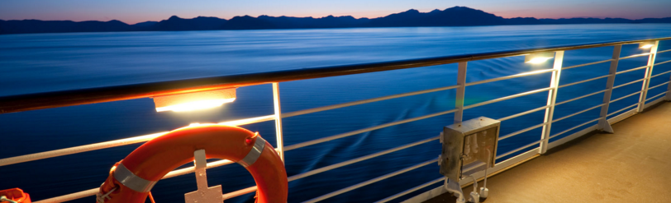
Mais de 1.000 portos
em todo o mundo

Slide 9
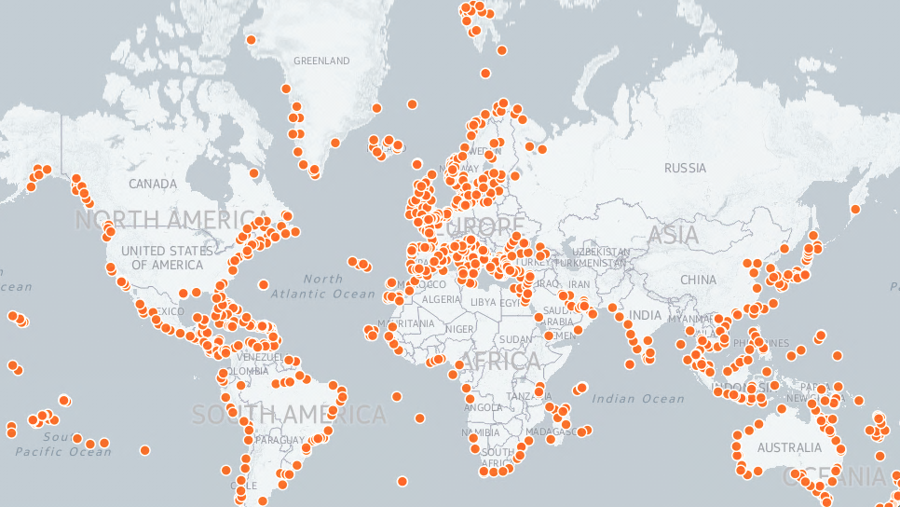
http://www.whatsinport.com/
Notes:
There are more than a thousand ports across the global, and the cruise industry is seeing an increase in passengers looking to get off-the-grid and explore more exotic destinations.
Includes many areas that fall within a UNESCO World Heritage Site, passengers are steeping themselves in the culture and history of new-to-cruise destinations.
Examples:
AMAWaterways AmaDara is offering incredible 16-night itineraries on the Mekong in Southeast Asia as part of the company’s AmaVoyages program featuring a once-in-a-lifetime overnight experience on an authentic contemporary junk.
Avalon is sailing the Irrawaddy with a new, 14-day itinerary – Golden Myanmar & The Alluring Irrawaddy – featuring a deluxe 10-night cruise from Began to Bhamo with hotel stays in Yangon.
Cunard Line on its 2016 World and Exotic Cruise program will travel to 92 unique destinations, including 32 maiden calls, in 47 countries on sailings up to 121 days aboard Queen Mary 2, Queen Victoria and Queen Elizabeth.
Spitsbergen, part of the Arctic’s Svalbard Islands and home to nearly 3,000 polar bears, is the focus of a new program of Explorer voyages offered by Hurtigruten.
Princess Cruises will once again offer an exciting season sailing from the two home ports of Tokyo (Yokohama) and Kobe.

Slide 10
ONDE ESTÃO OS NAVIOS?
▼
-2.1
▲
0.9
▼
-0.4
▲
0.8
▲
1.4
0.0
▼
-0.4
▼
-0.2
Notes:
Caribbean will always be queen for the cruise industry.
It owns more than a third of the global deployment capacity market share in 2015 for available beds.
At the same time, we do see that people are expanding their horizons.
The Mediterranean continues to grow and there is deployment of more ships to other destinations, like China and Australia.
For the close to home North American traveler, we’ve learned that:
About half (49%) of the market profile respondents are aware of close-to-home North American ports of embarkation.
A third (33%) have selected a cruise because of the proximity of the embarkation port.

Slide 11

NÚMEROS NO
BRASIL
Notes:
11

Slide 12
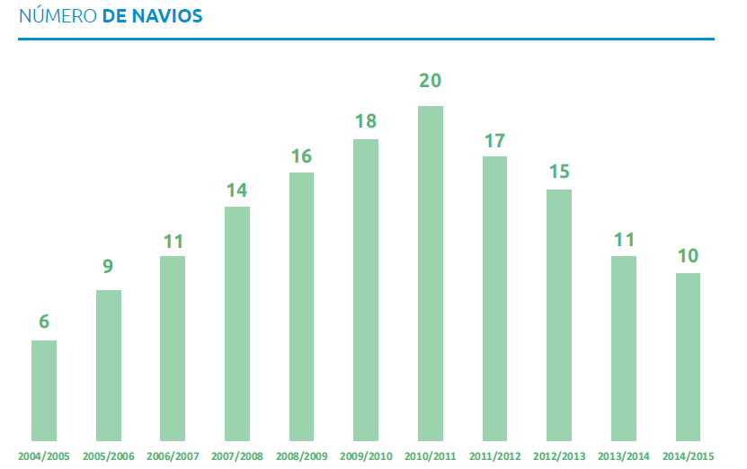
10
7
2015/2016
2016/2017

Slide 13
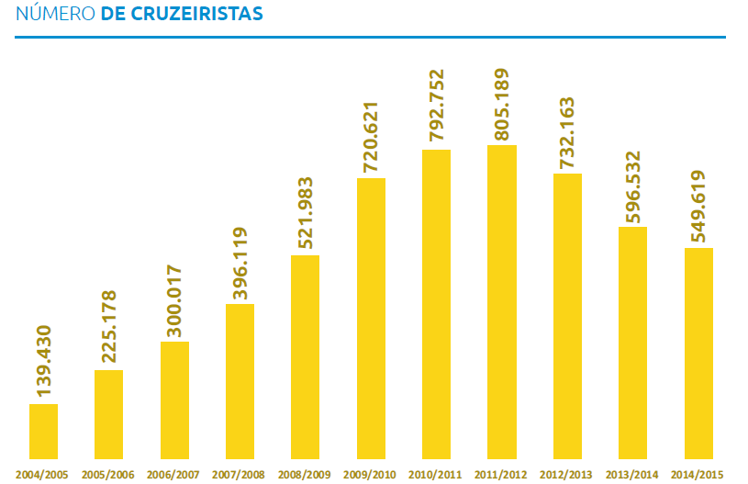

Slide 14
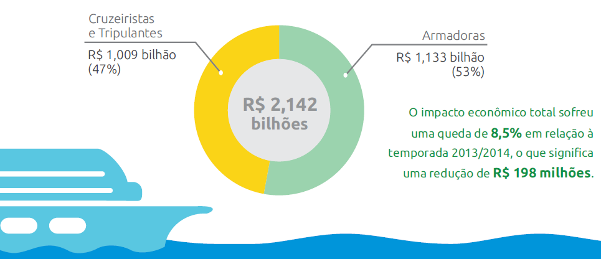
2014/2015

Slide 15

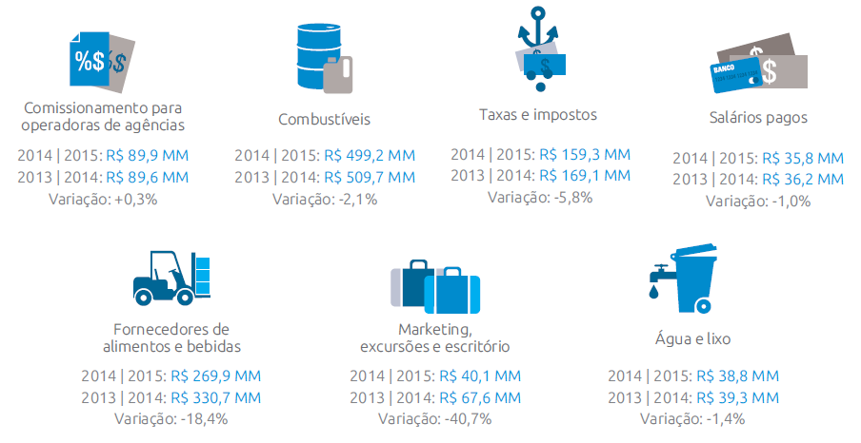
2014/2015

Slide 16
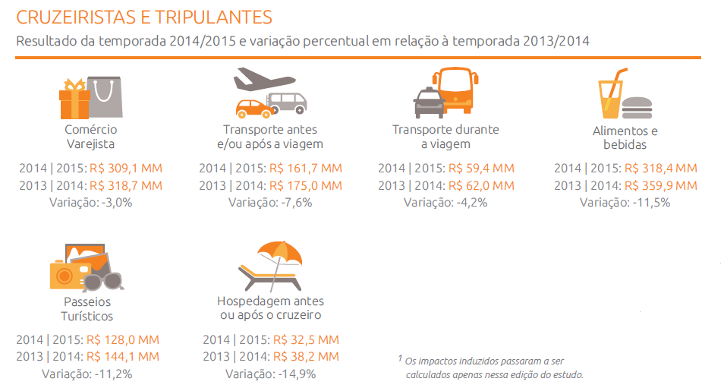
2014/2015

Slide 17
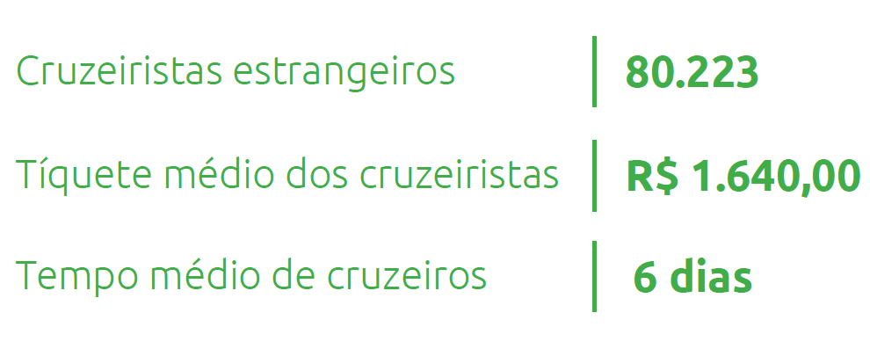

2014/2015

Slide 18


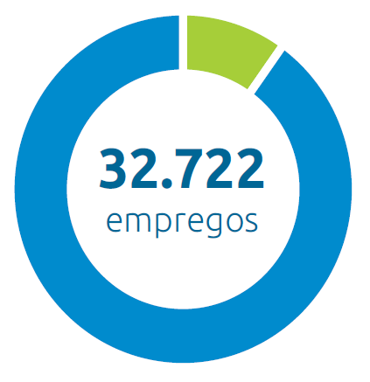
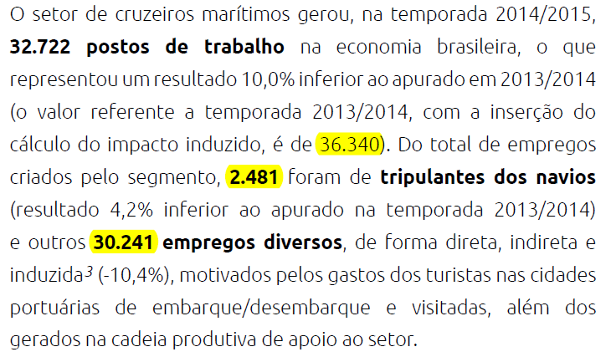
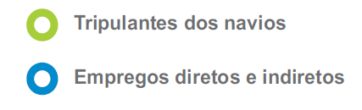
2014/2015

Slide 19
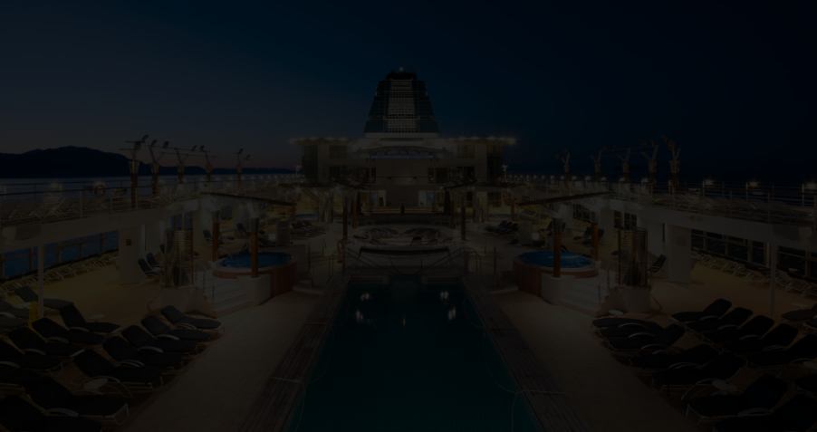
Temporada 2016/2017
Início - 21 de novembro
07 Navios
COSTA PACIFICA | COSTA FASCINOSA
MSC MUSICA | MSC PREZIOSA |MSC ORCHESTRA
NCL SUN
PULLMANTUR SOVEREIGN (CVC VIAGENS)
Notes:
MARIA MILLER
Adam shared such great information on the state of our industry, now I’d like to provide an overview of the outlook for the cruise industry in 2015.
It is no surprise that it is positive.
We’ve got a great story to tell that is summed up in seven areas.

Slide 20
Temporada 2016/2017
547 Escalas
108 Roteiros | 381 Mil leitos
Notes:
MARIA MILLER
Adam shared such great information on the state of our industry, now I’d like to provide an overview of the outlook for the cruise industry in 2015.
It is no surprise that it is positive.
We’ve got a great story to tell that is summed up in seven areas.

Slide 21
Temporada 2016/2017
26 Destinos
ANGRA DOS REIS | BUENOS AIRES | BUZIOS | CABO FRIO | CABO HORN | CHACABUCO | CHILLEAN FJORDS | ESTREITO MAGALHÃES | FORTALEZA | ILHA GRANDE | ILHABELA | ILHEUS | MACEIO | MONTEVIDEO | PORT STANLEY | PORTO BELO | PUERTO MADRYN | PUERTO MONTT | PUNTA ARENAS | PUNTA DEL ESTE | RECIFE | RIO DE JANEIRO | SALVADOR | SANTOS | USHUAIA | VALPARAISO
Notes:
MARIA MILLER
Adam shared such great information on the state of our industry, now I’d like to provide an overview of the outlook for the cruise industry in 2015.
It is no surprise that it is positive.
We’ve got a great story to tell that is summed up in seven areas.

Slide 22
DESAFIOS DO NOSSO TRABALHO
Regulação do Setor
Impostos
Infraestrutura
Promoção
Redução de Custos

Slide 23
Praticagem
Serviços de alta categoria
Cidades/Portos que visitamos e contratamos o serviço de Praticagem
ANGRA DOS REIS | FORTALEZA | ILHA GRANDE | ILHABELA | ILHEUS | MACEIO | RECIFE | RIO DE JANEIRO | SALVADOR | SANTOS |
Total Praticagem 16/17 – R$32,10mi
Notes:
MARIA MILLER
Adam shared such great information on the state of our industry, now I’d like to provide an overview of the outlook for the cruise industry in 2015.
It is no surprise that it is positive.
We’ve got a great story to tell that is summed up in seven areas.

Slide 24
Praticagem
Questão Comercial
Valores de Praticagem in/out – Navio MSC Preziosa / 139mTon / 2000 cabines
ANGRA DOS REIS – R$120mil
FORTALEZA – R$98 mil
ILHA GRANDE – R$120 mil
ILHABELA – R$117 mil
ILHEUS – R$83 mil
MACEIO – R$55 mil
RECIFE – R$85 mil
RIO DE JANEIRO – R$104 mil
SALVADOR – R$141 mil
SANTOS – R$118 mil
Média – R$104,10mil
Notes:
MARIA MILLER
Adam shared such great information on the state of our industry, now I’d like to provide an overview of the outlook for the cruise industry in 2015.
It is no surprise that it is positive.
We’ve got a great story to tell that is summed up in seven areas.

Slide 25
Praticagem
Comparação Internacional
Valores de Praticagem in/out – Navio MSC Preziosa / 139mTon / 2000 cabines
New Jersey– U$14,3mil
Miami – U$11mil
Xiamen – U$11mil
Bruges – U$10mil
Sydney – U$9,7mil
Fort Lauderdale – U$9,3mil
Lisboa – U$8,2mil
Veneza – U$7,7mil
Valparaiso – U$6,9mil
Montevideo – U$6,8mil
Okinawa – U$5,6mil
Civitavecchia – U$5,6mil
Southampton – U$4,4mil
Barcelona – U$4,08mil
Athenas – U$3,6mil
Média – R$25,2 mil (U$7,87mil)
Notes:
MARIA MILLER
Adam shared such great information on the state of our industry, now I’d like to provide an overview of the outlook for the cruise industry in 2015.
It is no surprise that it is positive.
We’ve got a great story to tell that is summed up in seven areas.

Slide 26
Praticagem
Itinerário de 7 noites
Santos – Rio de Janeiro – Salvador – Ilhéus – Ilha Grande – Santos
Total de passageiros – 3780 (90% ocupação)
Cabines – 1,8 mil
Valor médio por pessoa – R$1640
Faturamento total – R$6.199 milhões
Praticagem do roteiro – R$566 mil (média de R$113,2mil)
Porcentagem do faturamento total – 9,13%
Ocupa a venda de 183 cabines
Ocupa a receita de 345 cruzeiristas
Pelos números internacionais, economizaríamos R$440mil / 141 cabines / 268 paxs
Notes:
MARIA MILLER
Adam shared such great information on the state of our industry, now I’d like to provide an overview of the outlook for the cruise industry in 2015.
It is no surprise that it is positive.
We’ve got a great story to tell that is summed up in seven areas.

Slide 27














ASSOCIADAS LOCAIS

Slide 28
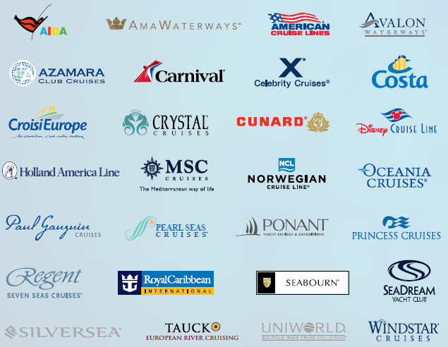
ASSOCIADAS GLOBAIS

Slide 29
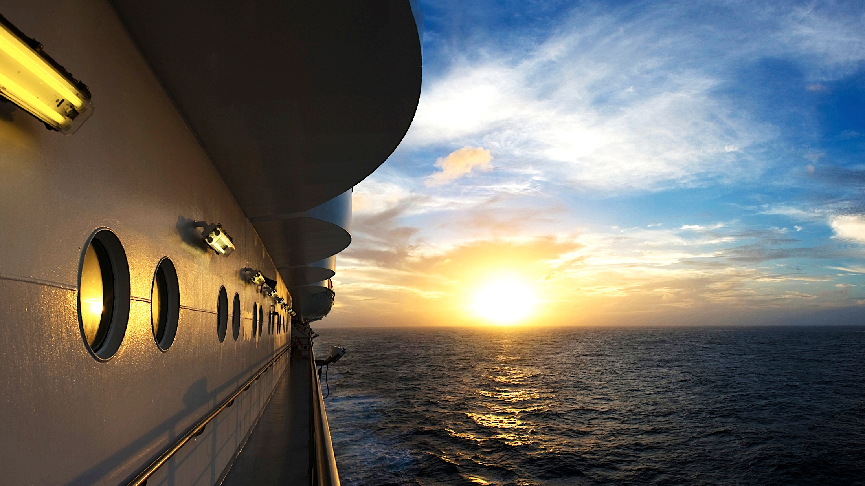
Obrigado!
Notes:
LORRI CHRISTOU
Thank you, Maria. You did a wonderful job speaking to our outlook and I look forward to working with you closely in the year ahead.
As promised, now I’d like to invite some key cruise lines executives to the stage to build on your presentation, specifically focused on “Passengers at the Helm.” The discussion will focus on travelers’ expectations and examples of how cruises are attracting today’s traveler.
The cruise executives will bring to life the cruise lines’ efforts to attract more passengers and share the exciting amenities and programming that they are offering in 2015.

