Slide 1

Seminário
Mineração na transição energética
Frente Parlamentar Mista da Mineração Sustentável (FPMIN)
ASX:MEI
May 2024

Slide 2
DISCLAIMER
The material in this Presentation has been prepared by Meteoric Resources NL (“Meteoric”) and is general background information about Meteoric’s current activities as at the date of this presentation. This information is given in summary form and does not purport to be complete. Information in this presentation, including forecast financial information, should not be considered as advice or a recommendation to investors or potential investors in relation to holding, purchasing or selling securities or other financial products or instruments and does not take into account your particular investment objectives, financial situation or needs.
Before acting on any information you should consider the appropriateness of the information having regard to these matters, any relevant offer document and in particular, you should seek independent financial advice. All securities and financial product or instrument transactions involve risks, which include (among others) the risk of adverse or unanticipated market, financial or political developments and, in international transactions, currency risk. This presentation may contain forward looking statements including statements regarding our intent, belief or current expectations with respect to Meteoric’s businesses, operations, market conditions, results of operation, financial condition, capital adequacy, specific provisions and risk management practices. Readers are cautioned not to place undue reliance on these forward-looking statements. Meteoric does not undertake any obligation to publicly release the result of any revisions to these forward-looking statements to reflect events or circumstances after the date hereof to reflect the occurrence of unanticipated events. While due care has been used in the preparation of forecast information, actual results may vary in a materially positive or negative manner. Forecasts and hypothetical examples are subject to uncertainty and contingencies outside Meteoric’s control. Past performance is not a reliable indication of future performance.
Competent Persons’ Statements
The information in this presentation that relates to exploration results is based on information reviewed, collated and fairly represented by Dr Andrew Tunks a Competent Person and a Member of Australian Institute of Geoscientists #2820 and a consultant to Meteoric Resources NL. Dr Tunks has sufficient experience relevant to the style of mineralisation and type of deposit under consideration, and to the activity which has been undertaken, to qualify as a Competent Person as defined in the 2012 Edition of the Joint Ore Reserves Committee (JORC) Australasian Code for Reporting of Exploration Results. Dr. Tunks consents to the inclusion in this report of the matters based on this information in the form and context in which it appears. The Company confirms that all material assumptions and technical parameters underpinning the exploration results in this report continue to apply and have not materially changed. The Company is not aware of any new information or data that materially affects the information included in this release.
The information in this presentation that relates to exploration results is based on information reviewed, collated and fairly represented by Dr Carvalho a Competent Person and aa Member of the Australasian Institute of Mining and Metallurgy and a consultant to Meteoric Resources NL. Dr.Carvalho has sufficient experience relevant to the style of mineralisation and type of deposit under consideration, and to the activity which has been undertaken, to qualify as a Competent Person as defined in the 2012 Edition of the Joint Ore Reserves Committee (JORC) Australasian Code for Reporting of Exploration Results, Mineral Resources and Ore Reserves. Dr. Carvalho consents to the inclusion in this report of the matters based on this information in the form and context in which it appears
The information in this presentation that relates to Mineral Resources is based on information compiled by Dr. Beck Nader, a Competent Person who is a Fellow of Australian Institute of Geoscientists #4472. Dr. Beck Nader is a consultant for BNA Mining Solutions. He has sufficient experience that is relevant to the style of mineralisation and type of deposit under consideration and to the activity being undertaken to qualify him as a Competent Person as defined in the 2012 Edition of the ‘Australasian Code for Reporting of Exploration Results, Mineral Resources and Ore Reserves’. Dr. Beck Nader consents to the inclusion in the report of the matters based on his information in the form and context in which it appears.
The information in this presentation that relates to Mineral Resources is based on information compiled by Dr. Volodymyr Myadzel, a Competent Person who is a Member of Australian Institute of Geoscientists #3974. Dr. Volodymyr Myadzel is a consultant for BNA Mining Solutions. He has sufficient experience that is relevant to the style of mineralisation and type of deposit under consideration and to the activity being undertaken to qualify as a Competent Person as defined in the 2012 Edition of the ‘Australasian Code for Reporting of Exploration Results, Mineral Resources and Ore Reserves’. Dr. Volodymyr Myadzel consents to the inclusion in the report of the matters based on his information in the form and context in which it appears.
March 2024

Slide 3
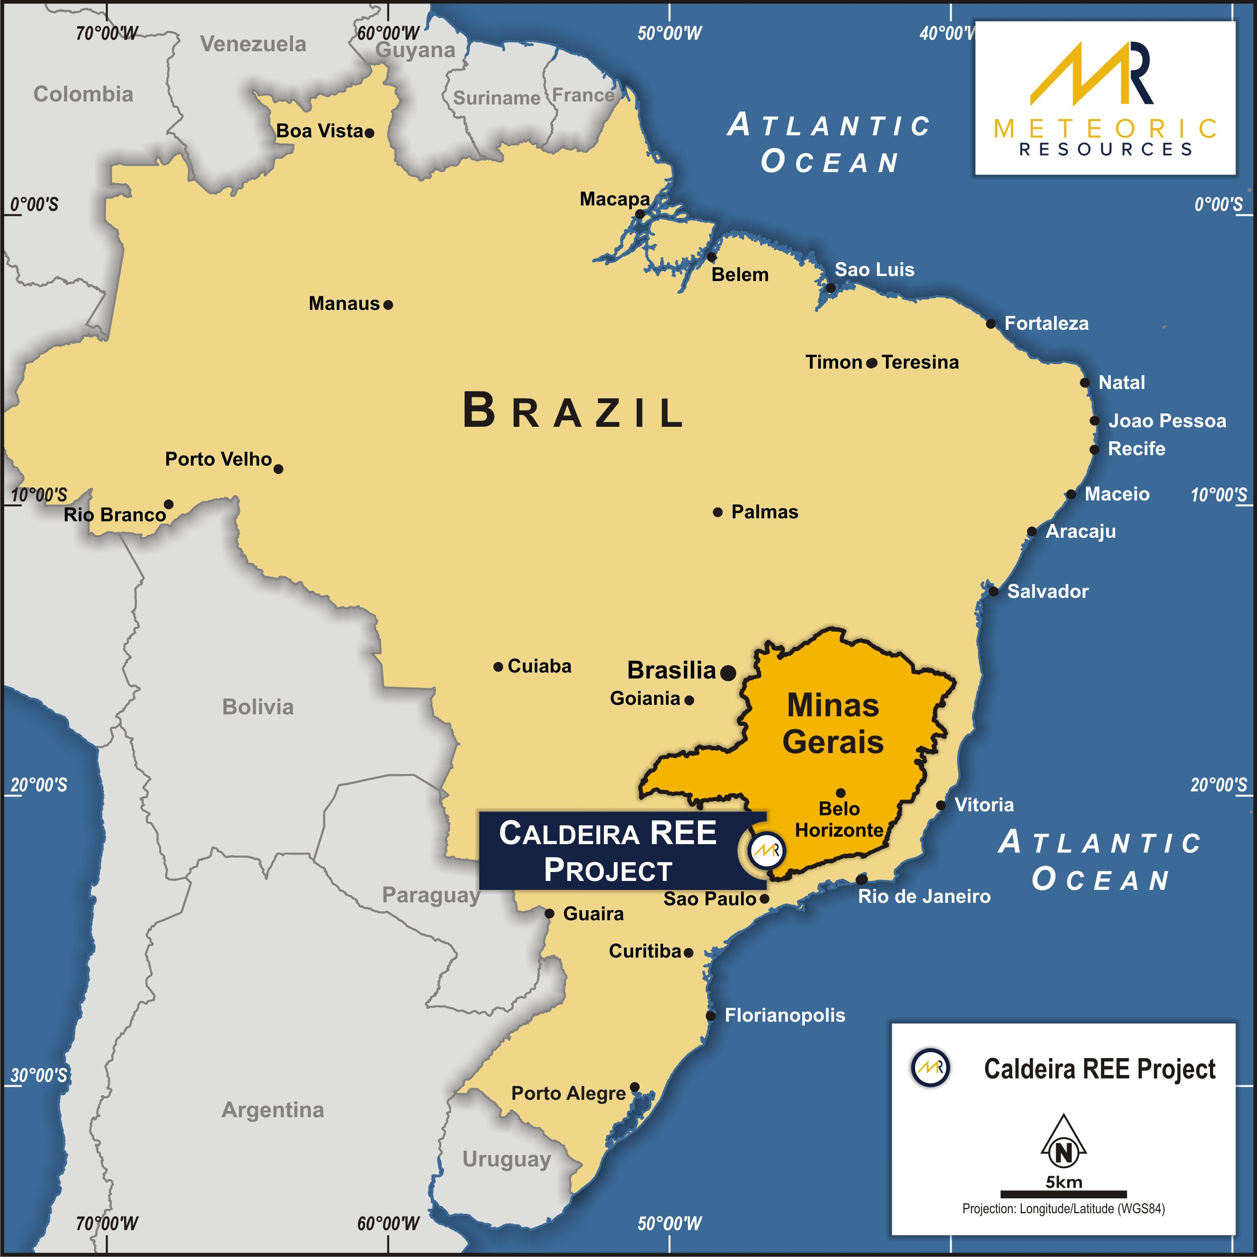
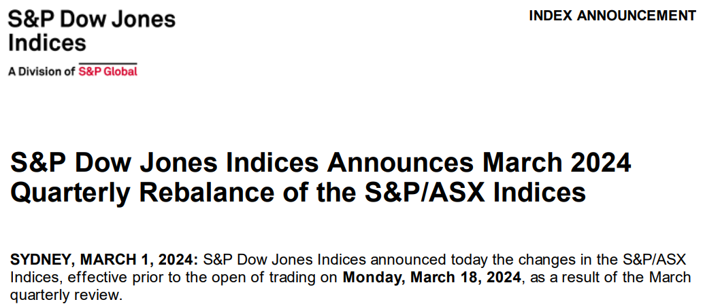
CORPORATE OVERVIEW
Supported by an experienced and competent Board
Meteoric Admitted into the ASX 300
MEI Snapshot
ASX Code | MEI
Share Price (22/03/24 Close) | A$ 0.24
Shares on Issue | 1,940M
Market Capitalisation | A$477M / US$310M
Cash (1/03/2024) | A$ 29M
Liquidity (3-Month Avg.) | A$ 3M / day
Largest Shareholder | c. 8.47%
Board of Directors
Executive Chairman | Dr Andrew Tunks
Executive Director | Dr Marcelo de Carvalho
Non-Executive Director | Dr Paul Kitto
Non-Executive Director | Mr. Peter Gundy
Chief Executive Officer | Nick Holthouse
March 2024

Slide 4

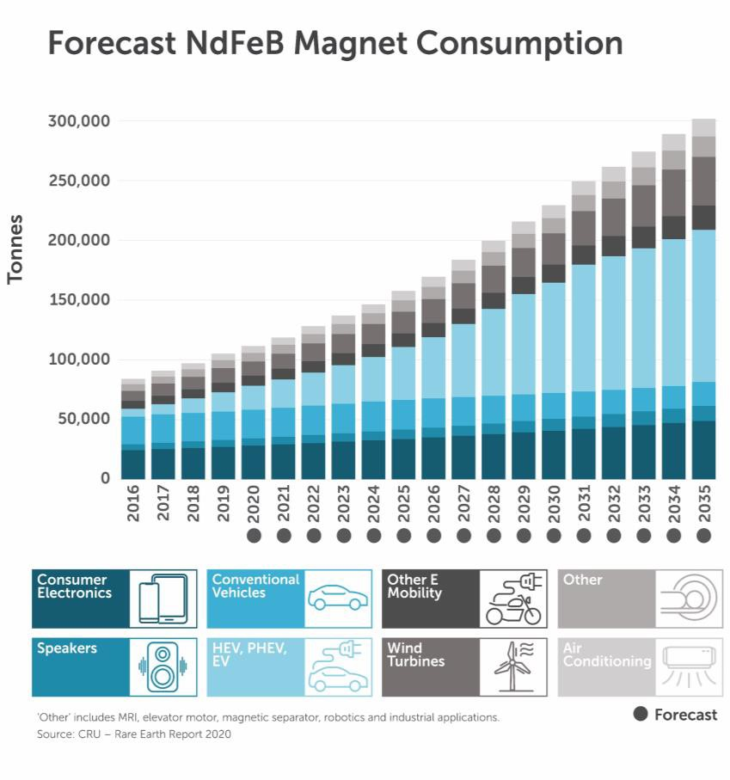

BRASIL NO QUADRO DA TRANSIÇÃO ENERGÉTICA
O Brasil é um player emergente nos minerais de transição energética e pode liderar esse mercado nos próximos anos
As empresas de lítio e o Vale do Lítio abriram a possibilidade de uma nova era industrial no Brasil.
Maioria dos depósitos de Argila Iônica (fora da China) estão no Brasil – mais por vir.
Melhores depósitos do mundo.
Grande investimento em exploração de argila iônica no mundo.
Todos os níveis de governo estão empenhados em ajudar as empresas a desenvolverem-se.

Slide 5
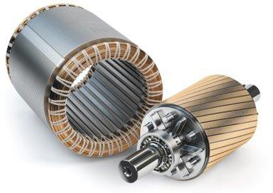
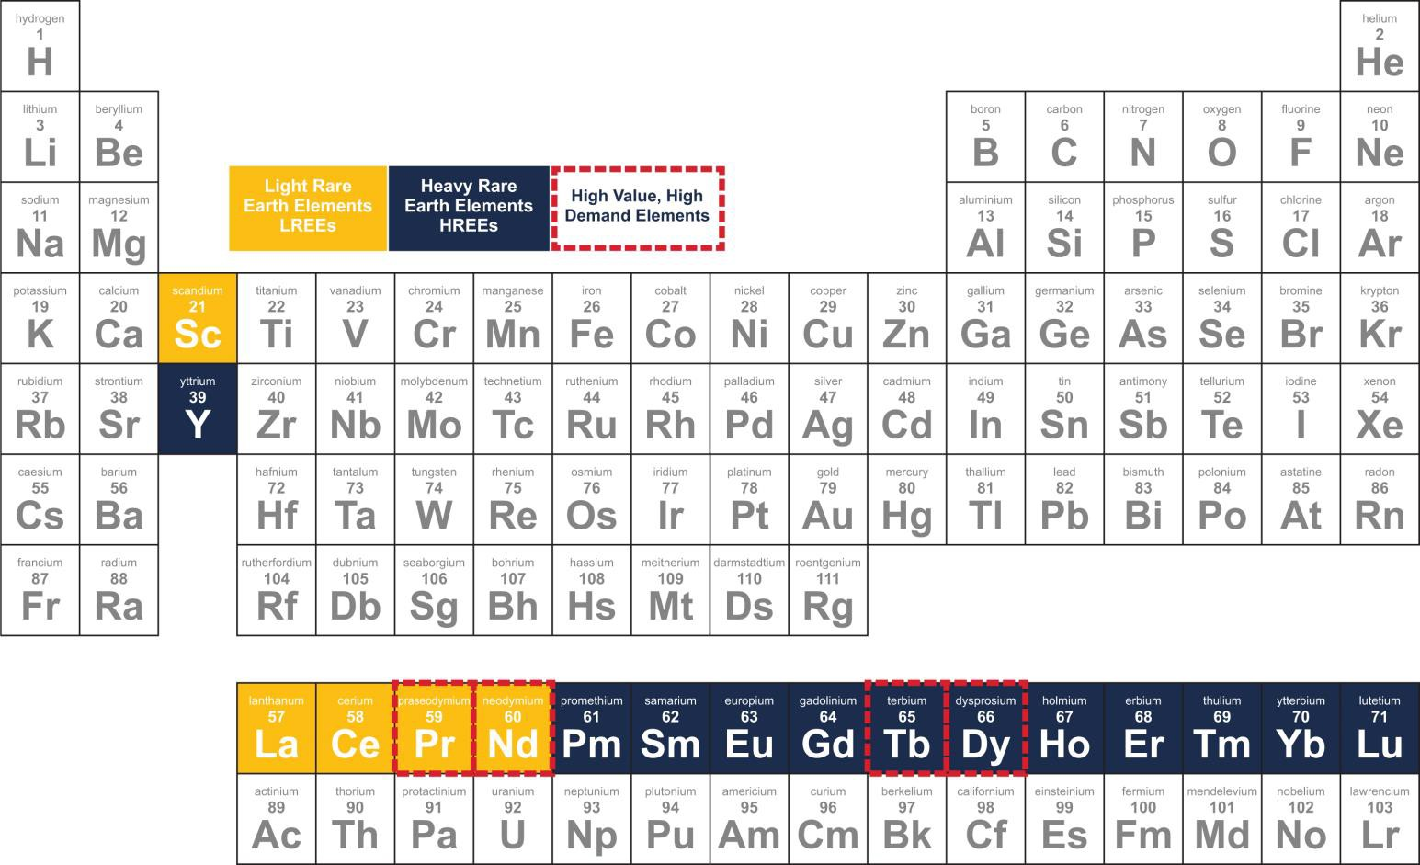
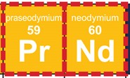
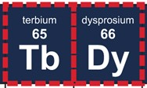
O QUE SÃO TERRAS RARAS?
4 REE have permanent magnet power
Light Rare Earth Elements
(LREE)
Heavy Rare Earth Elements (HREE)

Slide 6








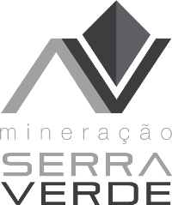





TIPOS DE DEPÓSITOS DE TERRAS RARAS E COMPARÁVEIS
Depósitos de argila iônica permite prazos de desenvolvimento acelerados, requisitos de investimento reduzidos e um produto de maior valor
Ionic Clay-hosted REE
Hard Rock-hosted REE
Escala | ✓ | O investimento inicial mais baixo permite maior escalabilidade Normalmente ~US$15/kg de produção anual de ETR (intensidade de capital)1 | ? | Normalmente ~US$150/kg de produção anual de ETR (intensidade de capital)
Mina | ✓ | Mineração de superfície, com remoção mínima de resíduos As cavas foram preenchidas sem deixar rejeitos ou depósitos de resíduos | ? | Perfurar e detonar com grande frota de mineração (normalmente, com altas taxas de decapagem) São necessárias operações a céu aberto e subterrâneas com uso intensivo de capital
Processo | ✓ | Dissolução simples de ETR de argila em sulfato de amônio Altas recuperações e nenhum fluxo de resíduos radioativos | ? | Craqueamento mineral em alta temperatura usando reagentes fortes para minerais REE Recuperações mais baixas e rejeitos muitas vezes radioativos e cuja eliminação é dispendiosa
Exploração | ✓ | Rápido e barato – perfuração de núcleo de ar raso em granito (argila) profundamente desgastado na superfície | ? | Semelhante a outros minerais de base de rocha dura que requerem perfuração e geoquímica substanciais
Produtos | ✓ | Contém ETR leves e pesados de alto valor (NdPr e DyTb) | ✓ | Normalmente apenas ETR leves (NdPr)
Operações | ? | Nenhuma operação ocidental estabelecida Primeiro projeto brasileiro (Serra Verde) com produção prevista para final de 2023 | ✓ | Dois produtores alinhados ao Ocidente com operações estabelecidas
Localização | ? | Extraído predominantemente na China e em Mianmar O Brasil é uma jurisdição emergente com 3 projetos de alta qualidade | ? | Maioria da produção baseada na China Operações na Austrália (Mt Weld) e EUA (Mountain Pass)
Notes: 1. Assumes that proposed institutional placement is fully subscribed and raises ~A$50 million (before offer costs). 2. Ordinary shares on issue as at [06 October] 2023.

Slide 7
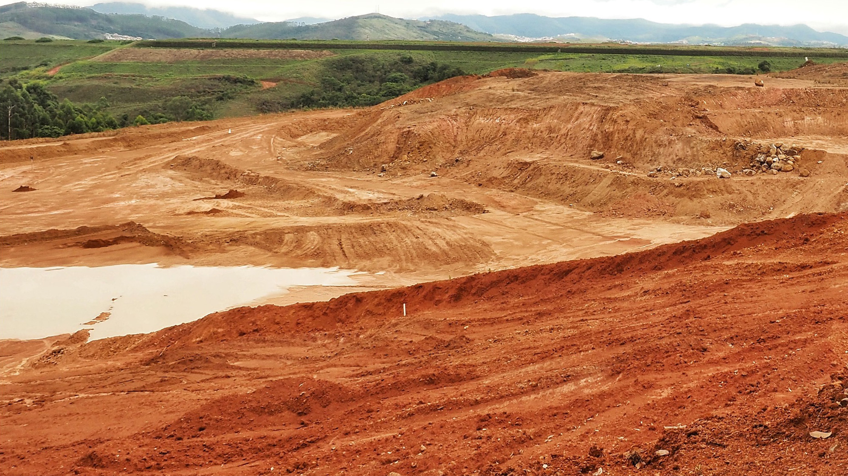

Resumo Executivo - Projeto Caldeira
Desenvolvendo o maior depósito de terras raras do mundo (IAC) – Fora da cadeia de abastecimento chinesa
Projeto de terras raras Classe Mundial, globalmente significativo, que abriga recursos de aproximadamente 530 milhões de toneladas, que podem ser ampliados para >1 B toneladas. Alto teor contido em argilas na superfície com baixa radioatividade in situ e recuperada.
2
O projeto tem vantagens claras sobre projetos comparáveis em teor, escala e metalurgia - uma oportunidade única para os EUA e UE garantirem o fornecimento estratégico de ER, que atualmente é dominado pela China.
1
Fluxograma de processo simples e ecologicamente correto, sem necessidade de perfuração e detonação, alta temperatura ou craqueamento cáustico, juntamente com lavagem com AMSOL para recuperação, permitindo que o MEI seja um projeto ESG de nível 1.
6
Localizado numa jurisdição mineira comprovada e estabelecida com regime fiscal favorável. Status de projeto de alta prioridade recebido do governo com Memorando de Entendimento estabelecido para priorizar licenciamento e aprovações
6
Caminho rápido para a produção – O estágio 1 é REO de 10 kt, aproximadamente 5% da demanda global de Nd/Pr para o mercado até 2027. Produção facilmente escalonável com REO de 20 kt planejado (7 kt NdPr) com escala de 10 a 15% para o mercado até 2030.
5
A empresa está procurando um parceiro ocidental para desenvolver o projeto e garantir a retirada e auxiliar no processamento downstream até ímãs ETR
3
Equipe de liderança experiente com histórico de criação de valor. Histórico comprovado de desenvolvimento de projetos e experiência central em terras raras e operação no Brasil.
4

Slide 8
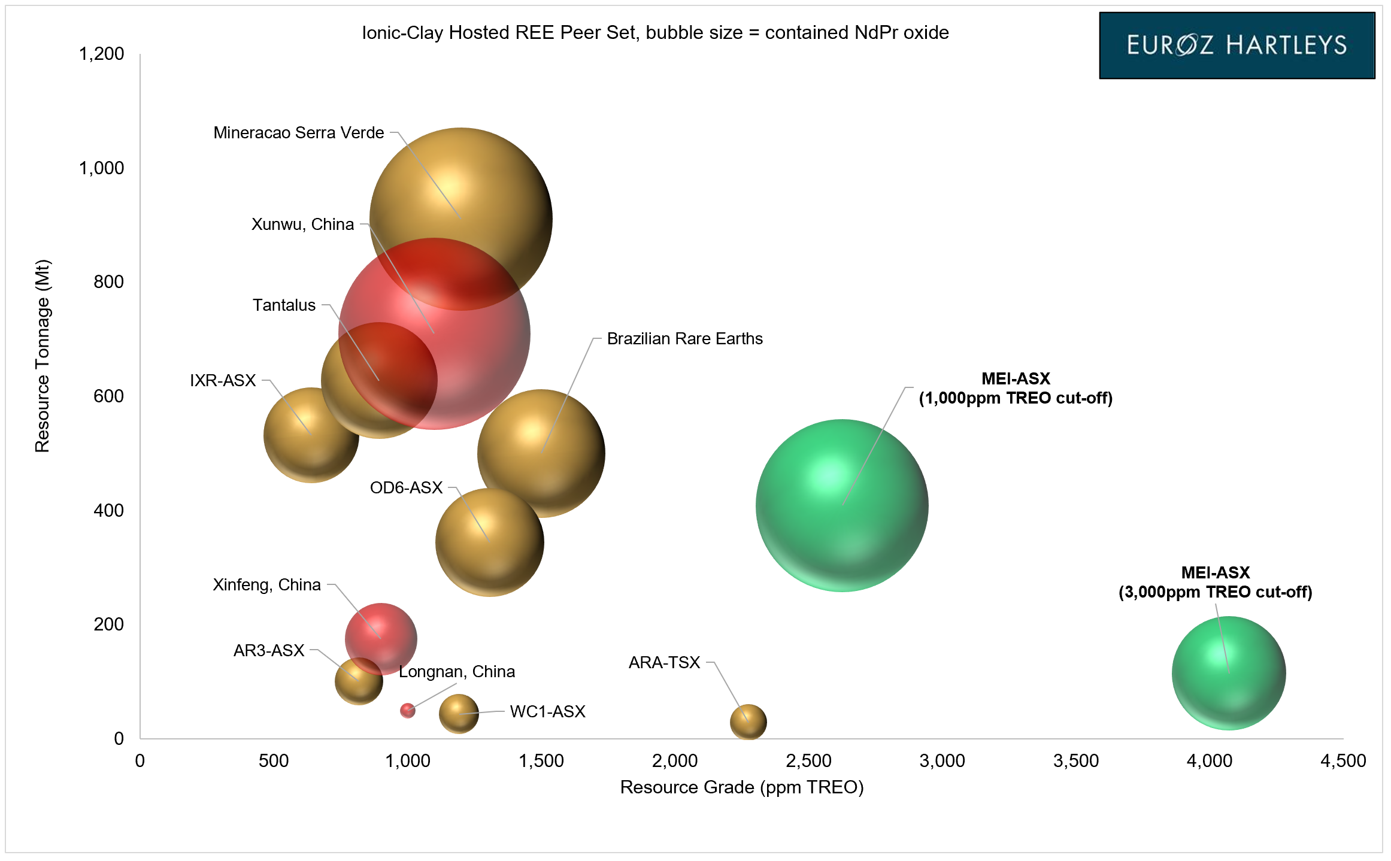
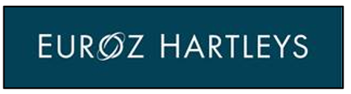
IONIC CLAY LANDSCAPE
Caldeira is the World’s Highest Grade Ionic Adsorption Clay REE Deposit
700ppm
1250ppm
March 2024

Slide 9


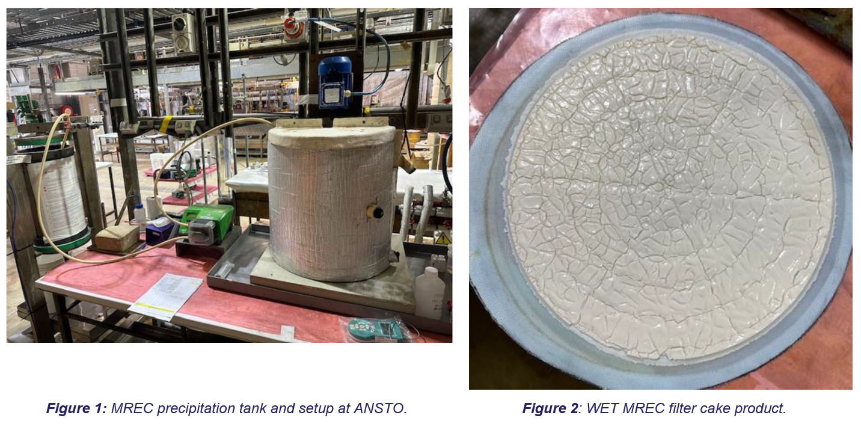
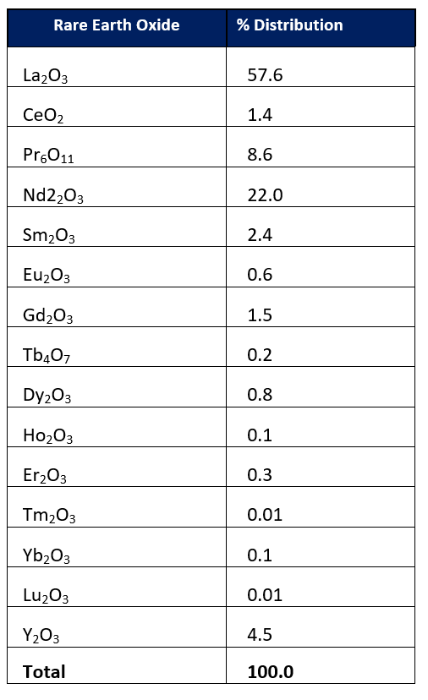
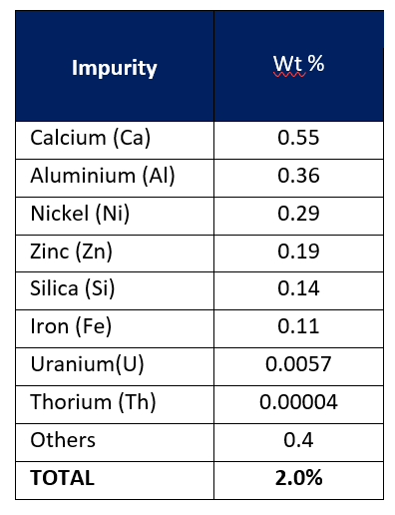
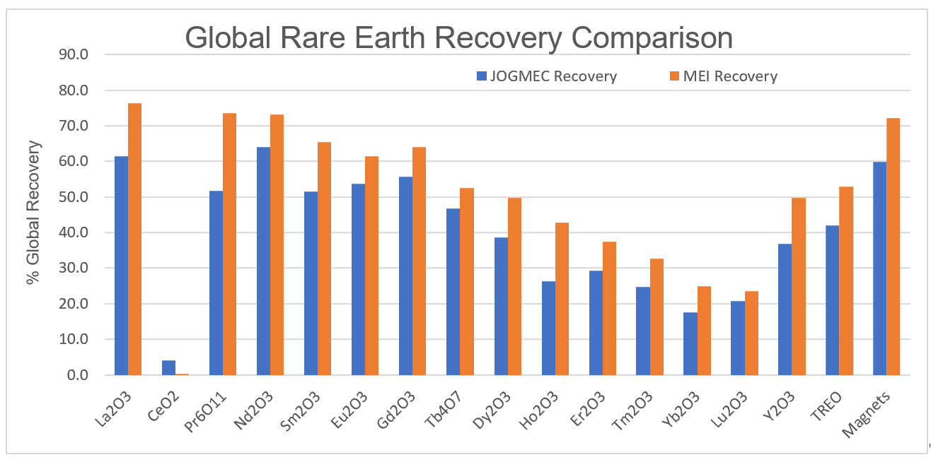
METALLURGICAL TESTWORK
The current test work program has proven the project’s IAC characteristics across all licenses
Weight % of impurities in MREC expressed as oxides
Rare earth distribution in the MREC
Improved Recoveries to MREC
  42% increase to Praseodymium (Pr) recoveries upgraded to 74%.
  14% increase to Neodymium (Nd) recoveries upgraded to 73%.
  29% increase to Dysprosium (Dy) recoveries upgraded to 50%.
  12% increase to Terbium (Tb) recoveries upgraded to 53%.
To Follow in 2024
  Materials handle and size fraction analysis – Q2 2024
  Continuous Piloting – Q3 2024
  All leading into the development of an optimised flowsheet and additional Met test work programmes - Q3 2024 onwards
March 2024

Slide 10
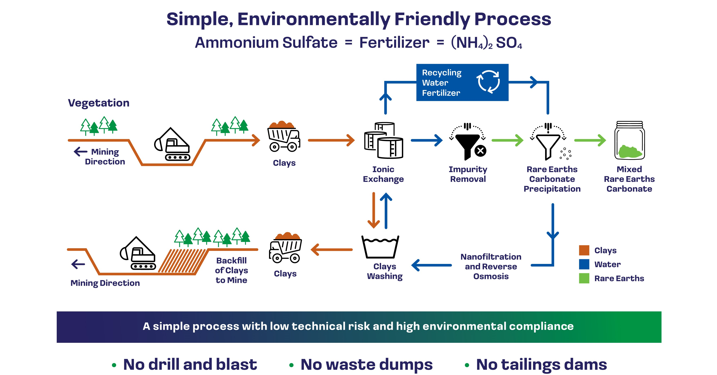
A Green Mine for Green Metals
Ionic adsorption clay project flow sheet - powered by 100% Hydro electricity.
March 2024

Slide 11

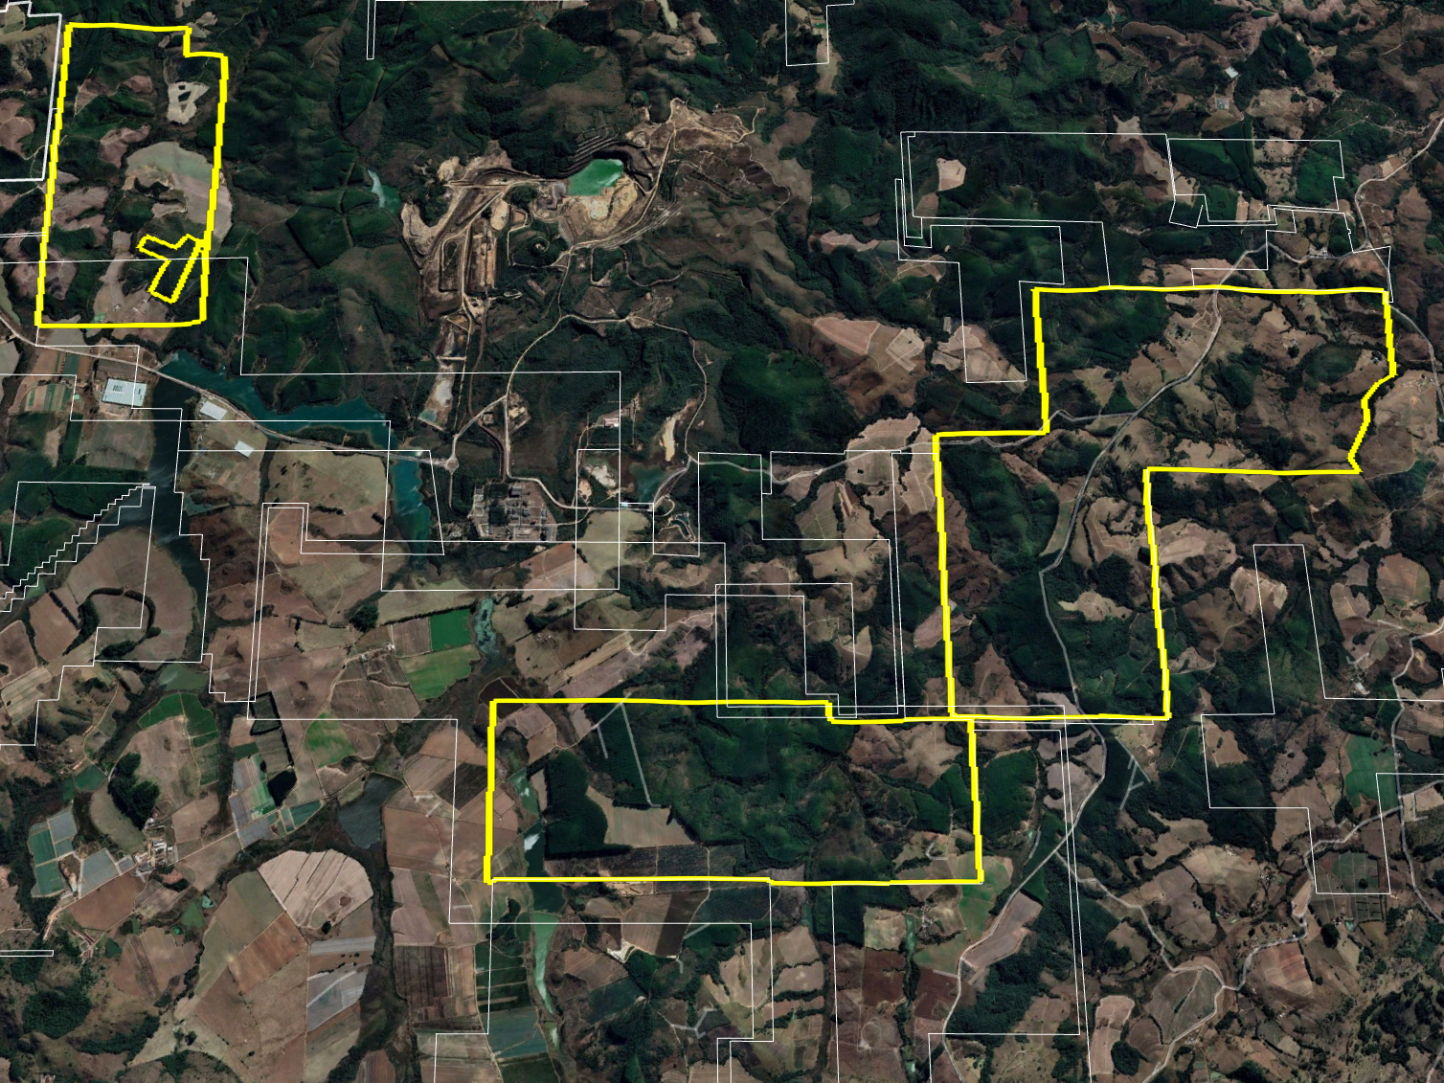


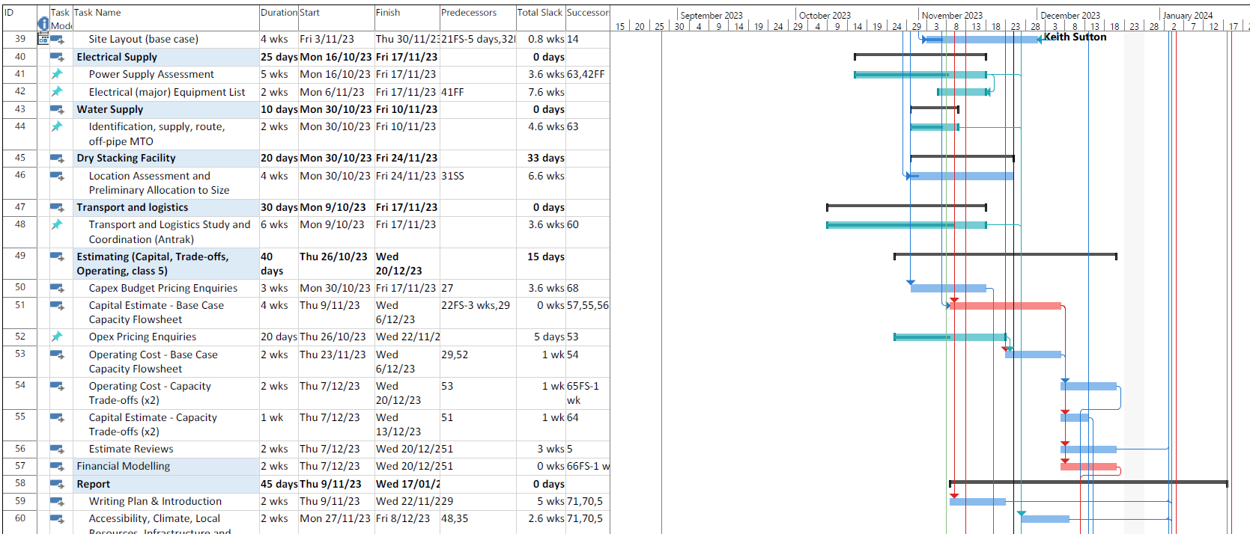
A PRÓXIMA E MAIS SUSTENTÁVEL MINA DE ETR DO MUNDO
Engineering
Ausenco Scoping Study completed – awaiting M and I resource update to announce financial metrics
Feasibility studies are underway - BFS or similar will be required by Lenders
Recruitment of GM Projects completed.
Figueira
Environmental
Alger remain on target for a Q2 2024 EIS Submission date
Q4 2025 Construction permit date holds
Soberbo
Metallurgy
Completion of Package 1 works with ANSTO in mid 2024
Develop onsite metallurgical capability with dedicated pilot plant, laboratory and local recruitment
Develop work programmes for ongoing test work both onsite and with external consultants
Capao de Mel
Plantsite
HIGH GRADE ZONE
Institutional Relations
Federal and State Governments relations, regulatory issues
Caputo Bastos e Serra
Frederico Bedran Oliveira
March 2024

Slide 12

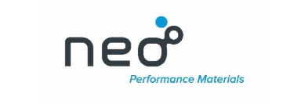
INVESTIMENTO, FINANCIAMENTO, PARCERIAS
INVESTIMENTO
R$ 1.5 Bilhões
Cerca de 700 empregos diretos.
FINANCIAMENTO
Carta de intenções assinadas com Exim bank USA
BNDES
BDLATAM
Outros fundos americanos
PARCERIAS
MOU assinados com Neo Performance Materials
FIEMG
Busca de parcerias estratégicas para o desenvolvimento da indústria de transformação mineral

Slide 13

A PRÓXIMA E MAIS SUSTENTÁVEL MINA DE ETR DO MUNDO
Focus is on 2025 for the construction permit and beyond with all key development packages progressing
2023
2024
2025
MILESTONE
Q1 | Q2 | Q3 | Q4 | Q1 | Q2 | Q3 | Q4 | Q1 | Q2 | Q3 | Q4
Caldeira Purchase Completion
DD Complete
Diamond Drilling – Phase 1 & 2
Phase 1 – Res. Dev.
Phase 2 - Exploration
Metallurgy
ANSTO Test work
Metallurgical Optimisation Programmes
Resource Development
JORC Resource
Infill Resource Drilling- SB / CDM / FG and Resource updates
Maiden Reserve
Exploration – Outside Resource Areas
Mapping, Soil Sampling, Auger, Drilling (2nd MEI Rig) à
Engineering
Scoping Study
Feasibility Study – Hydrogeology, Geotech, Mining & FEED
Environmental Preliminary License (LP)
EIS – Baseline Studies
EIS Review Period by EPA
Environmental Control Plan (PCA)
PCA – Environmental Control Plan
PCA – Review Period by EPA
Key:
Permit to Construct
Underway
Completed
Planned Works
March 2024
Notes:
Phase 2 drilling in outlying license areas that require conversion to mining licenses from application and exploration licenses
ANSTO test work underway, carbonate optimisation, solid liquid separation, materials handling testwork, flowsheet development and continuous piloting
Infill drilling with aircore rig southern tenement areas
ID basement, GPR for basement mapping
Scoping study with engineering group
Baseline studies with EIA consultant – recent announcement around the MOU with Minas Gerais government

Slide 14
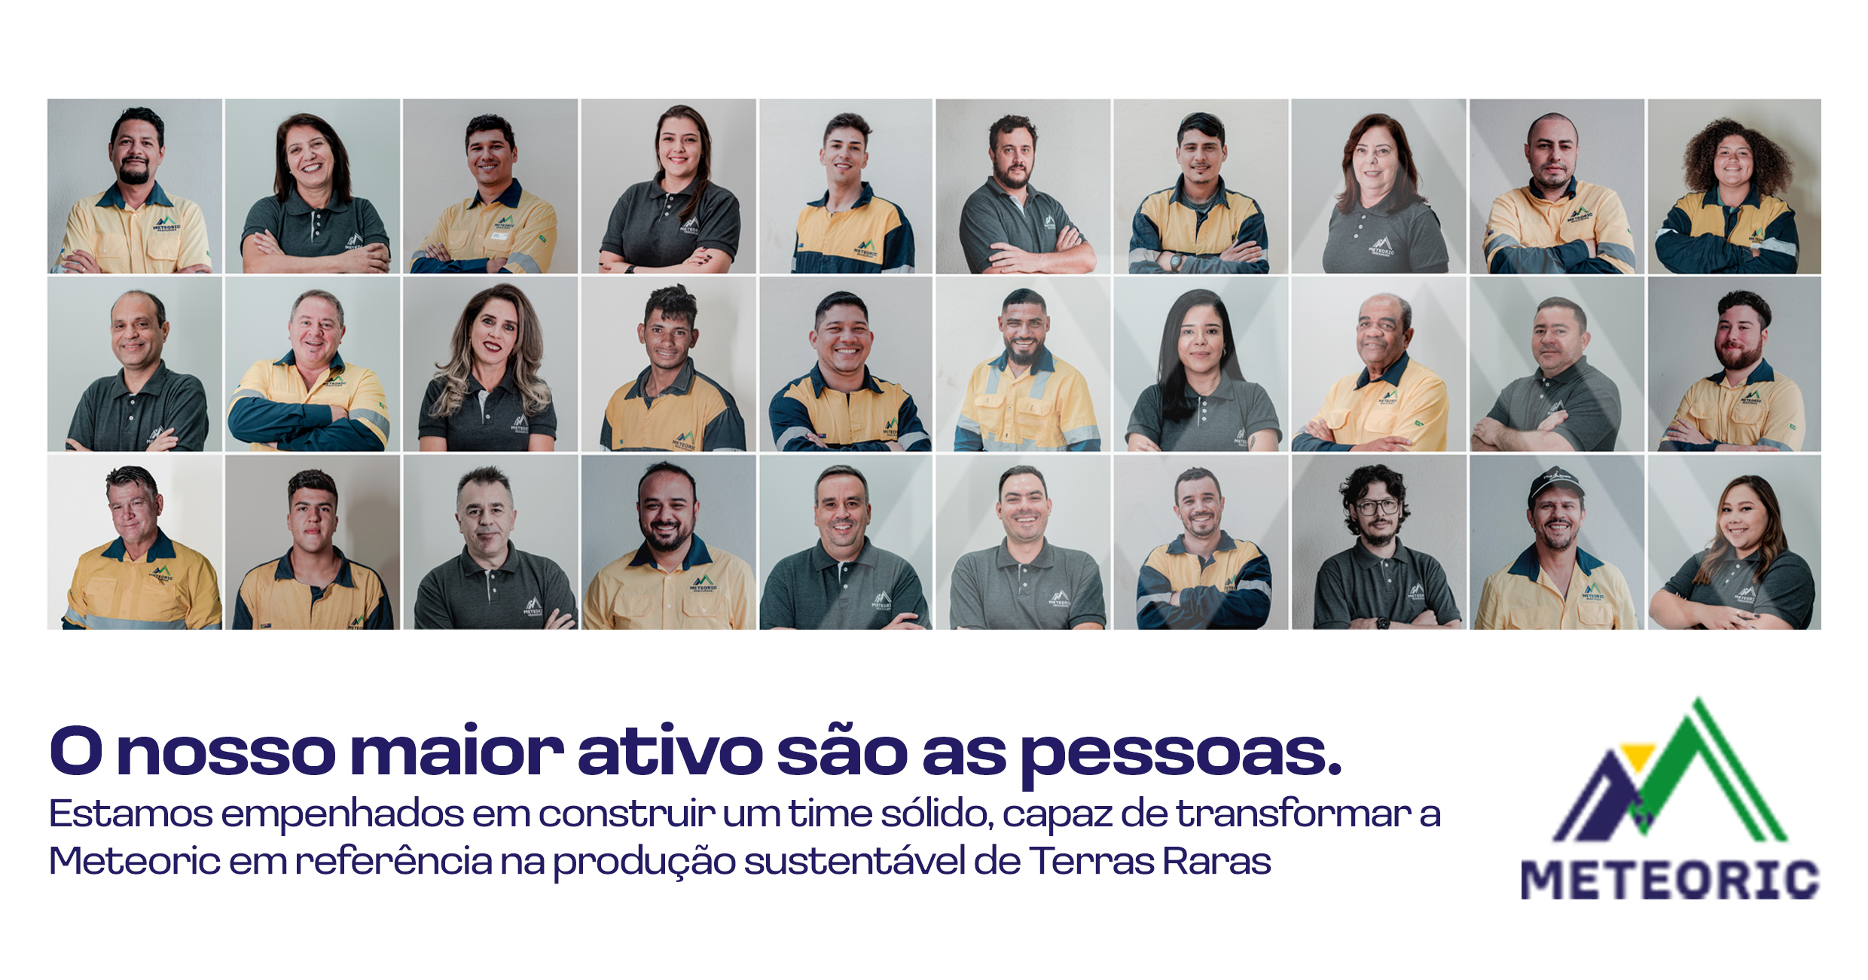

Slide 15


Contact Information
Meteoric Resources
ABN 64 107 985 651
W www.meteoric.com.au
A Level 1, 35 Ventnor Avenue, West Perth WA 6005
Dr Marcelo Carvalho – Executive Director
T +55 61 986130930
E mdecarvalho@meteoric.com.au
Nick Holthouse – CEO
T +61 428 964 276
E nholthouse@meteoric.com.au
ASX:MEI

