Slide 1
Visão geral do sistema internacional de direitos humanos
Angela Pires Terto
Assessora Nacional de Direitos Humanos

Slide 2
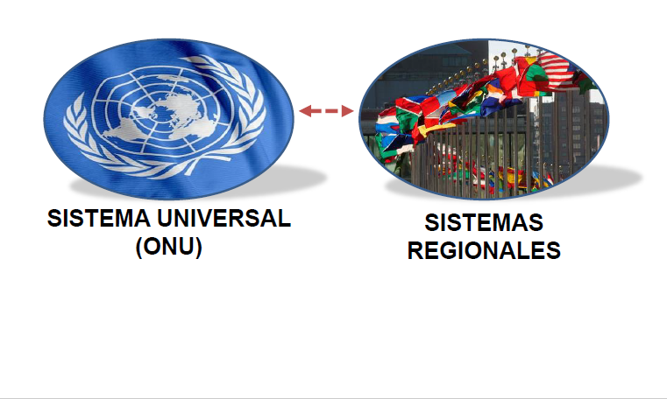
Sistemas de Proteção dos Direitos Humanos

Slide 3
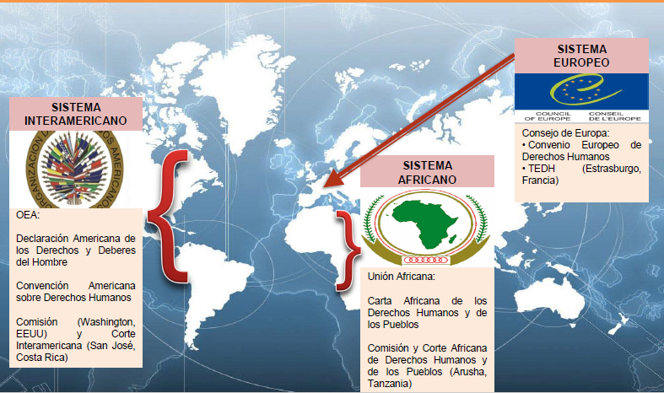
Sistemas regionais

Slide 4
Principais mecanismos de direitos humanos da ONU
Assembleia Geral
Secretariado
ACNUDH*
*O ACNUDH apoia o trabalho dos mecanismos e do Conselho de Direitos Humanos
Adotar
Criar
Tratados de Direitos Humanos
Conselho de Direitos Humanos
Órgãos de Tratados
(Comitês)
Revisão Periódica Universal
Procedimentos especiais
Notes:
GA adopts treaties. This treaties establish each a treaty body (committee). So, treaty-based bodies are set up as a result of legally binding human rights treaties
Charter-based bodies are set up as a result of resolutions and decisions of the UN system. This is the case of the Human Rights Council which was created by a resolution adopted by the GA.
Charter bodies are those which have been created using the authority of the UN Charter. They are political bodies, meaning that either members of the body represent their governments or individuals are appointed to their role by governments. Charter-based bodies can address issues in any country, but it is important to keep in mind that their political nature also has an impact on their effectiveness.
In contrast, treaty-based bodies get their authority from UN human rights treaties (legal agreements between states). Treaty bodies can be considered more effective than Charter bodies, as they come from legal instruments. However, they can only address issues in states that have accepted the treaty.

Slide 5
Visão geral dos tratados internacionais de direitos humanos
Fenômenos específicos
Grupos específicos
Declaração Universal
dos direitos humanos
Convenção Internacional sobre a eliminação de todas as formas de Discriminação Racial
Convenção Internacional sobre a Eliminação de Todas as Formas de Discriminação contra as Mulheres
Pacto Internacional sobre os Direitos Civis e Políticos
Convenção contra a tortura e outras penas ou tratamentos cruéis, desumanos ou degradantes
Convenção sobre os Direitos da Criança
Pacto Internacional sobre Direitos Econômicos, Sociais e Culturais
Convenção sobre os Direitos dos Trabalhadores Migrantes e Membros de Suas Famílias
Convenção sobre o Desaparecimento Forçado
Convenção sobre os Direitos das Pessoas com Deficiência
Notes:
Recap/overview of the core international human rights treaties
The Universal Declaration of Human Rights (10 December 1948) forms the basis of the two covenants—The International Covenant on Economic, Social and Cultural Rights, and the International Covenant on Civil and Political Rights
The process of drafting a legally-binding instrument enshrining the rights of the UDHR had started immediately after the declaration’s adoption in 1948. Initially a single Covenant encompassing all human rights was envisaged. However, after long discussion, the GA requested the CHR two elaborate two separate Covenants, which were ultimately adopted by the GA in December 1966 and entered into force in 1966. The two Covenants have a similar structure and, is some articles, adopt the same or a very similar wording.
Treaties addressing specific phenomena (ICERD, CAT and CED) vs. specific groups (CEDAW, CRC, ICRMW and CRPD)
Legally binding treaties negotiated and adopted by States within the framework of the United Nations General Assembly
Obligations undertaken voluntarily by States
Once ratified/acceded to, treaty obligations are not optional: legally binding obligations

Slide 6
Os tratados de direitos humanos
Tratados legalmente vinculantes negociados e adotados pelos Estados no âmbito da Assembleia Geral das Nações Unidas.
Obrigações assumidas voluntariamente pelos Estados
Uma vez ratificada / aderida, as obrigações do tratado não são opcionais: obrigações juridicamente vinculativas
As obrigações implicam uma tripla responsabilidade de:
Respeitar (Abster-se de violar um direito ...)
Proteger (Prevenir violações de um direito ...)
Promover (Tomar medidas para garantir a realização de um direito ...)
Notes:
E.g. right to adequate food
Respect: requires States not to take any measures that would result in preventing individuals from having access to adequate food (eg deliberate starvation of its people)
Protect: requires measures by the State to ensure that third parties (individuals, armed groups, enterprises, etc.) do not deprive right-holders of their access to adequate food
Fulfill: adopt measures aimed at improving right-holders’ access to and utilisation of resources and means to ensure their livelihood

Slide 7
INSTRUMENTOS INTERNACIONAIS
Datas de adoção pelo Brasil
CONVENÇÃO INTERNACIONAL SOBRE OS DIREITOS DAS PESSOAS COM DEFICIÊNCIA
2008 + OPCRPD (2008)
CONVENÇÃO SOBRE OS DIREITOS DA CRIANÇA
1990 + OP-AC (2004); OP-SC (2004)
CONVENÇÃO CONTRA A TORTURA E OUTROS TRATAMENTOS OU PENAS CRUÉIS, DESUMANOS OU DEGRADANTES
1989 + OP-CAT (2007)
CONVENÇÃO PARA A ELIMINAÇÃO DE TODAS AS FORMAS DE DISCRIMINAÇÃO CONTRA A MULHER
1984
PACTO INTERNACIONAL SOBRE DIREITOS CIVIS E POLÍTICOS
1992 + OP-ICCPR (2009); OP2-ICCPR (2009)
PACTO INTERNACIONAL DOS DIREITOS ECONÔMICOS, SOCIAIS E CULTURAIS
1992
CONVENÇÃO INTERNACIONAL SOBRE A ELIMINAÇÃO DE TODAS AS FORMAS DE DISCRIMINAÇÃO
1968
CONVENÇÃO INTERNACIONAL PARA A PROTEÇÃO DE TODAS AS PESSOAS CONTRA OS DESAPARECIMENTOS FORÇADOS
2010
CONVENÇÃO INTERNACIONAL PARA A PROTEÇÃO DOS DIREITOS DE TODOS OS TRABALHADORES MIGRANTES E SUAS FAMÍLIAS
Brasil NÃO ratificou:
Conv. Int. para a proteção dos direitos dos trabalhadores migrantes e famílias CMW + procedimento de comunicações individuais
Procedimento de comunicações individuais CED e CDESC

Slide 8
Mecanismos de direitos humanos
ASSEMBLEIA GERAL
MECANISMO MECANISMO
CONVENCIONAL EXTRACONVENCIONAL
Tratados internacionais
Conselho de Direitos Humanos
Procedimentos Especiais
Órgaos de tratados
56
Revisão Periódica Universal

Slide 9
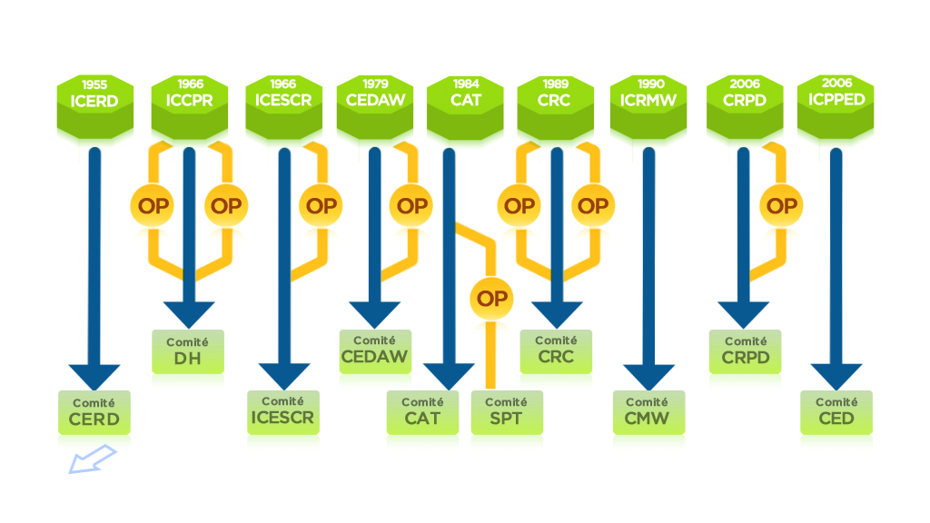

O sistema de tratados de direitos humanos da ONU
Notes:
Each of the HRs treaties provides for the establishment of a Committee of independent expert = a treaty body. In addition, the OPCAT creates as well a treaty body. Therefore → 10 Treaty bodies.
1. Committee on the Elimination of Racial Discrimination (CERD)
2. Human Rights Committee (HRCttee)
3. Committee on Economic, Social and Cultural Rights (CESCR)
4. Committee on the Elimination of Discrimination against Women
(CEDAW)
5. Committee against Torture (CAT)
6. Committee on the Rights of the Child (CRC)
7. Committee on Migrant Workers (CMW)
8. Committee on the Rights of Persons with Disabilities (CRPD)
9. Committee on Enforced Disappearances (CED)
10. Subcommittee on Prevention of Torture (SPT)

Slide 10
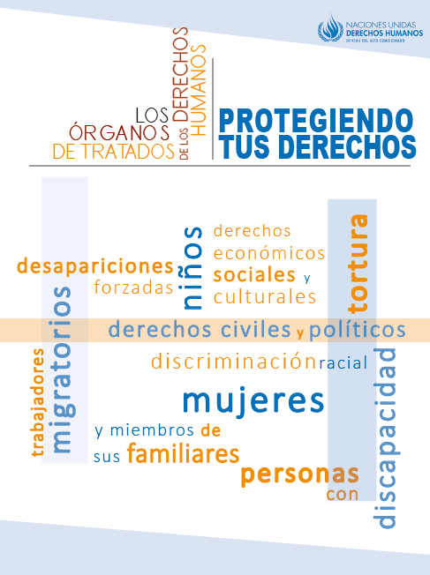
Órgãos de Tratado
Mandato: monitorar a implementação do tratado pertinente pelos Estados Partes.
Filiação: 10 a 25 membros,
Em total: 172 integrantes (10 órgãos)
Compostos de especialistas independentes, nomeados e eleitos pelos Estados Partes por períodos fixos renováveis de quatro anos
Não remunerado e servem em sua capacidade pessoal
Critérios: Experiência, distribuição geográfica equitativa, representação dos principais sistemas jurídicos e diferentes formas de civilização e representação equilibrada de gêneros
Se reúnem para uma sessão de 1 a 4 semanas, de 2 a 3 vezes por ano em Genebra.
https://www.ohchr.org/EN/HRBodies/Pages/HumanRightsBodies.aspx
Notes:
Treaty bodies:
Established under each treaty
Composed of independent experts, nominated and elected by States parties for fixed, renewable terms of four years
Membership: 10-25 members depending the Committee
Currently 172 members in total (10 TBs)
Criteria: Expertise, equitable geographical distribution, representation of principal legal systems and different forms of civilization and balanced gender representation
Non-remunerated, and serve solely in their personal capacity

Slide 11
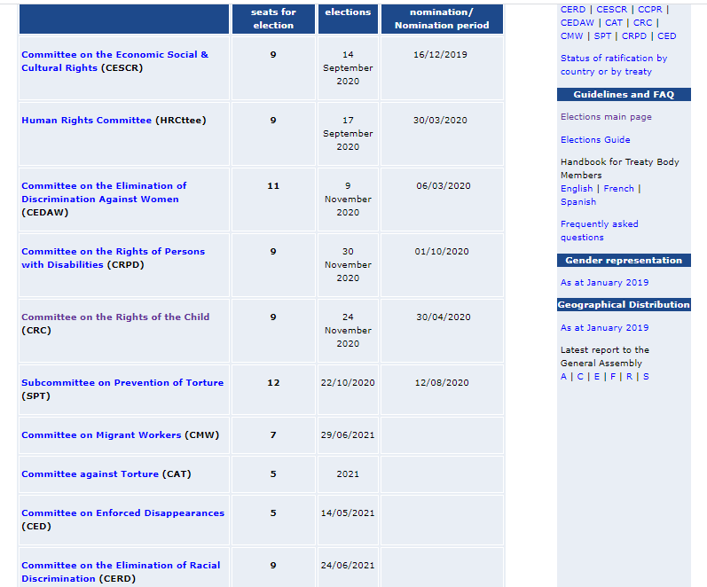
Órgãos de Tratado – eleições abertas
https://www.ohchr.org/EN/HRBodies/Pages/upcomingelections.aspx

Slide 12
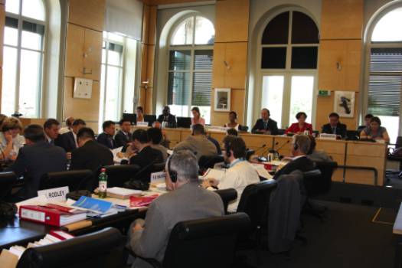
CERD
18 especialistas independentes
Mandato de 4 anos (Art. 8)
Realiza 2 sessões por ano (3 semanas cada)
Monitorar a implementação
  Informes a cada 2 anos
Interpretação
  Comentários gerais
Analisar comunicações
  Individuais e Interestatais
  “early warning”
https://www.ohchr.org/en/hrbodies/cerd/pages/cerdindex.aspx

Slide 13
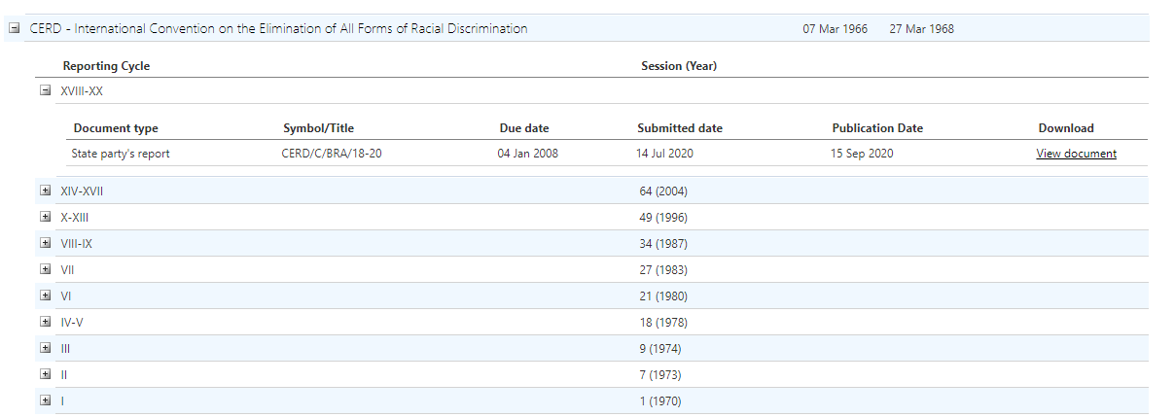
CERD
Exame dos países
http://tbinternet.ohchr.org/_layouts/TreatyBodyExternal/countries.aspx?CountryCode=BRA&Lang=EN
Notes:
The Jewish community of Oslo et al. v. Norway

Slide 14
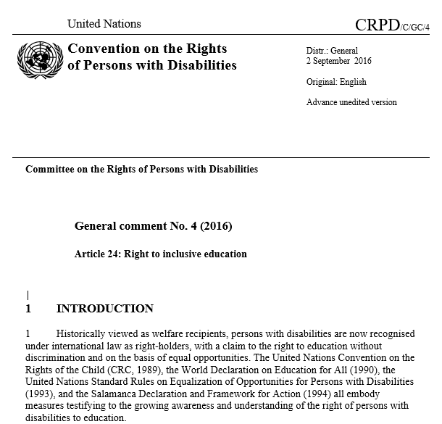
CRPD – Direitos da Pessoa com Deficiência
Interpretação – comentários gerais
https://www.ohchr.org/Documents/HRBodies/CRPD/GC/RighttoEducation/CRPD-C-GC-4.doc

Slide 15
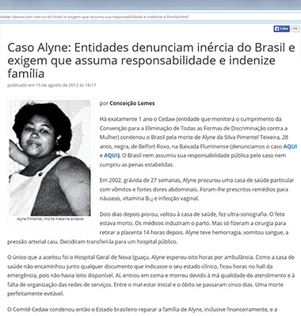
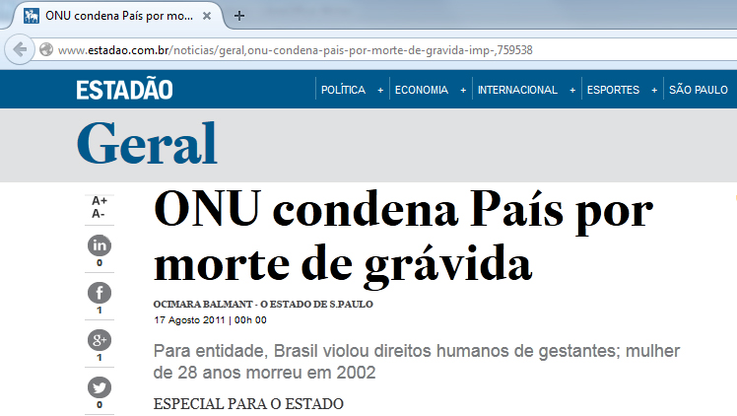
CEDAW
Comunicações Individuais
http://www2.ohchr.org/english/law/docs/CEDAW-C-49-D-17-2008_en.pdf

Slide 16
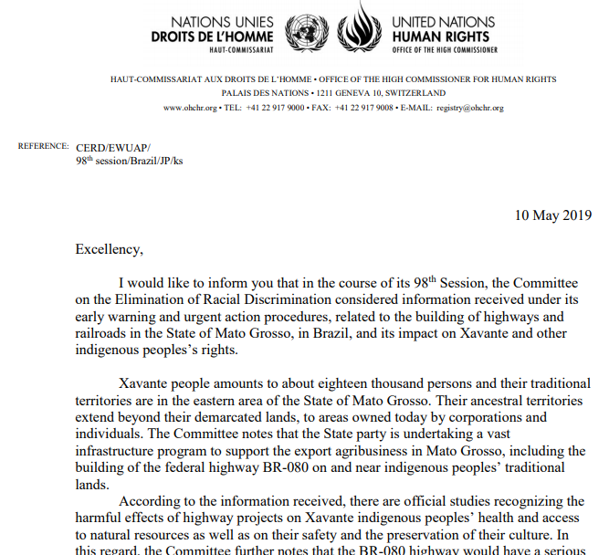
CERD
Comunicações Individuais – early warning procedure
https://tbinternet.ohchr.org/Treaties/CERD/Shared%20Documents/BRA/INT_CERD_ALE_BRA_8925_E.pdf

Slide 17
Mecanismos de direitos humanos
ASSEMBLEIA GERAL
MECANISMO MECANISMO
CONVENCIONAL EXTRACONVENCIONAL
Tratados internacionais
Conselho de Direitos Humanos
Procedimentos Especiais
Órgaos de tratados
56
Revisão Periódica Universal

Slide 18
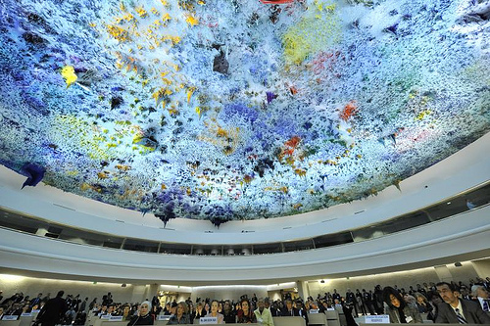
Conselho de Direitos Humanos
Órgão Intergovernamental
47 membros
Assistido pelo ACNUDH
Resolver violações dos direitos humanos
Trabalhar para evitar abusos dos direitos humanos
Responder a emergências
Fórum Internacional para o Diálogo sobre os Direitos Humanos
Recomenda o desenvolvimento do direito internacional dos direitos humanos
Revisar periodicamente a situação dos países (RPU)
Notes:
Questions 4, 5 and 6
HRC is an intergovernmental body composed of 47 member states
Main mechanisms established under the HRC: UPR and Special Procedures (quick overview)
HUMAN RIGHTS COUNCIL
-Created by the General Assembly in 2006
-Members elected directly by the General Assembly
-Guided by the principles of universality, impartiality, objectivity and non-selectivity
-Universal Periodic Review
-Ability to convene special sessions to respond promptly to human rights crises
-OHCHR provides support for the meetings of the Council and a follow-up to deliberations
The Human Rights Council, which meets in Geneva 10 weeks a year, was created by the General Assembly in 2006 to replace the Human Rights Commission. It is composed of 47 elected United Nations Member States who serve for an initial period of 3 years, and cannot be elected for more than two consecutive terms. The Human Rights Council is a forum where all Member States can discuss human rights issues, but also promote and make human rights a priority issue.
The expanded mandate of the Council includes making recommendations to the General Assembly for further development to international human rights law and undertaking a Universal Periodic Review of the fulfillment of each State of its human rights obligations and commitments. The Human Rights Council also has the ability to react quickly to human rights emergencies in countries. OHCHR provides support for the meetings of the Human Rights Council, and follow-up to the Council’s deliberations.
QUESTIONS AND ANSWERS ON THE HUMAN RIGHTS COUNCIL
1. How many members the Human Rights Council has?
The Council consists of 47 members, as compared to the 53-member Commission on Human Rights.
2. How are members elected?
Membership to the Council is open to all Member States of the United Nations. Members are elected by the General Assembly through individual and direct votes by absolute majority (96 votes). The distribution of seats is in accordance with equitable geographical representation (13 from the African Group; 13 from the Asian Group; 6 from the Eastern European Group; 8 from the Latin American and Caribbean Group; and 7 from the Western European and Other States Group).
3. How is this election procedure for Council membership different from the Commission on Human Rights?
The election procedure calls for an absolute majority of the entire membership of the General Assembly. Election to the Commission on Human Rights was by the 54 member Economic and Social Council through a majority of those present and voting.
4. What are the expectations of the members to the Council?
When voting for members of the Council, member states will take into consideration a candidates' contribution to the promotion and protection of human rights. Upon election, new members commit themselves to cooperating with the Council and to upholding the highest standards in the promotion and protection of human rights. Candidates to the Council also submit voluntary pledges and commitments with regard to the promotion and protection of human rights. These expectations did not exist for the Commission on Human Rights.
5. How the Council ensure that its members abide by these human rights standards?
Members of the Council undergo the Council's new universal review mechanism during their term of membership. The Universal Periodic Review (UPR) is a unique process which involves a review of the human rights records of all 192 UN Member States once every four years. The UPR is a State-driven process, under the auspices of the Human Rights Council, which provides the opportunity for each State to declare what actions they have taken to improve the human rights situations in their countries and to fulfil their human rights obligations. As one of the main features of the Council, the UPR is designed to ensure equal treatment for every country when their human rights situations are assessed.
6. Could a Member have its rights and privileges suspended in the Council?
The General Assembly would have the right to suspend the rights and privileges of any Council Member that it decides has persistently committed gross and systematic violations of human rights during its term of membership. This process of suspension would require a two-thirds majority vote by the General Assembly.
7. How long are the terms of membership?
Members will be elected for three year terms. They would not be eligible for immediate re-election after serving two consecutive terms.
8. Where does the Human Rights Council fit in within the United Nations system?
The Human Rights Council is a subsidiary body of the General Assembly. This makes it directly accountable to the full membership of the United Nations.
9. Where and how often does the Council meet?
The Human Rights Council is based in Geneva and holds no fewer than three sessions per year (including a main session) for a total period of no less than ten weeks. The Commission met in one annual six-week session. The Council is also able to convene to deal with urgent situations, and to hold special sessions when necessary through a request by a Member of the Council with the support of one-third of the membership of the Council.
10. Do non-governmental organizations and other observers participate in the proceedings of the Council as they did with the Commission on Human Rights?
Observers, including non-governmental organizations, intergovernmental organizations, national human rights institutions and specialized agencies, participate in the Council through the same arrangements and practices that applied to the Commission.
11. How is the work of the special mechanisms of the Commission on Human Rights – independent experts, treaty bodies, and special rapporteurs –affected by the establishment of the Council?
The Council carried over all the Commission's mandates and responsibilities to ensure that there was not a protection gap in the transition. The Council continues to work closely with the UN Special Procedures established by the former Commission on Human Rights and assumed by the Council. In 2007 the Council adopted its “Institution-building package” providing elements to guide it in its future work. Among the elements is the Universal Periodic Review mechanism which will assess the human rights situations in all 192 UN Member States. Other features include a new Advisory Committee which serves as the Council’s “think tank” providing it with expertise and advice on thematic human rights issues and the revised Complaints Procedure mechanism which allows individuals and organizations to bring complaints about human rights violations to the attention of the Council.
12. What is the relationship be between the United Nations High Commissioner for Human Rights and the Human Rights Council?
The Council assumes the role and responsibilities of the Commission on Human Rights relating to the work of the Office of the High Commissioner.
13. How can the main objectives of the Human Rights Council be summarized?
The Council serves as the main United Nations forum for dialogue and cooperation on human rights. Its focus is to help member states meet their human rights obligations through dialogue, capacity building, and technical assistance. The Council also makes recommendations to the General Assembly for further development of international law in the field of human rights.

Slide 19
Mecanismos do CDH : Procedimentos Especiais
56 procedimentos especiais*
  44 mandatos temáticos
  12 mandatos relacionados con países ou territorios
Nomeados pelo Conselho de Direitos Humanos
Monitoramento de direitos humanos em diferentes países ou temas específicos
Investigação de temas de preocupação
Visitas a países
Receber e considerar queixas diretas
Apelos a governos
Responder a emergencias
Informam ao Conselho de Direitos Humanos
Notes:
SPECIAL PROCEDURES
Mechanisms established by the Human Rights Council to address:
- Specific country situations
- Thematic issues in all parts of the world
Who are the Special Procedures Mandate Holders and how do they work?
- Special procedures commonly are either an individual, called a special rapporteur or representative or an independent expert, or a group of individuals, called a working group.
- Special Procedures mandate holders are independent: fully free from governmental or non-governmental pressure, they report to the Council on their findings and recommendations.
-Work on a voluntary basis
-Appointed by the Human Rights Council
-14 country mandates (Belarus, Cambodia, Central African Republic, Côte d’Ivoire, DPRK, Eritrea, Haiti, the Islamic Republic of Iran, Mali, Myanmar, the Palestinian territories, Somalia, Sudan and Syria), as of 27 March 2015.
-41 Thematic Mandates, as of 27 March 2015.
-Report to the Human Rights Council.
-Conduct research, country visits, receive complaints, and engage governments
-Thematic mandate periods will be of three years. Country mandate periods will be of one year. Mandate-holders may not exceeded a six‑year term limit.
- Special Rapporteurs are sometimes the only mechanism that will alert the international community on certain human rights issues.
OHCHR provides personnel and logistical support to mandate holders
Special procedures:
The special procedures are considered the most effective, flexible and responsive mechanisms within the UN human rights system. The Council’s review of these procedures aims to strengthen the system and to ensure greater synergy with other human rights mechanisms within the UN system.
The Council agreed to criteria and established a process for the continuing review, rationalization and improvement of all special procedure mandates was established by the Council;
Any decision to streamline, merge or eventually discontinue mandates will be guided by the need for improvement of the enjoyment and protection of human rights;
The Council’s existing thirty-eight country and thematic special procedures will be reviewed in accordance with a schedule to be agreed upon by the Council;
An agreed process and general criteria for the selection of special procedure mandate-holders will ensure that individuals with the highest standards of expertise, experience, independence and impartiality are selected;
A “Code of Conduct” for mandate-holders aimed at strengthening the effectiveness of the system and the capacity of mandate-holders to exercise their functions was also adopted by the Council. It will enhance their moral authority and credibility and requires supportive action by other stakeholders, in particular by States.

Slide 20
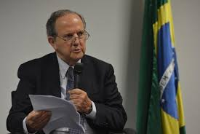
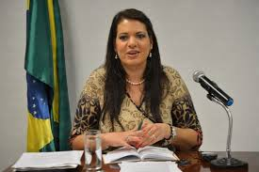
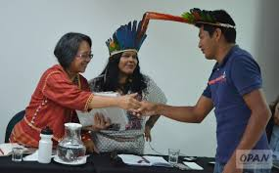
Relatoria sobre Tortura e Outras penas e tratamentos cruéis, desumanos e degradantes
Procedimentos Especiais – visitas mais recentes
Juan Mendez
Relatoria sobre Questões de Minorias
Rita Iszak
Relatoria sobre Direitos dos Povos Indígenas
Victoria Tauil-Corpuz

Slide 21
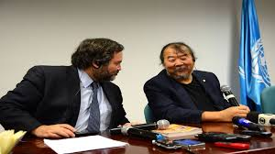
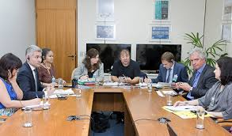
Procedimentos Especiais – visitas mais recentes
GT Empresas e Direitos Humanos
http://www.ohchr.org/EN/Issues/Business/Pages/WGHRandtransnationalcorporationsandotherbusiness.aspx

Slide 22
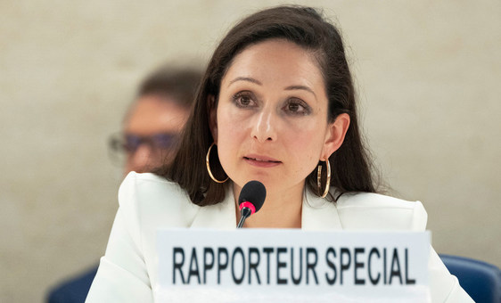
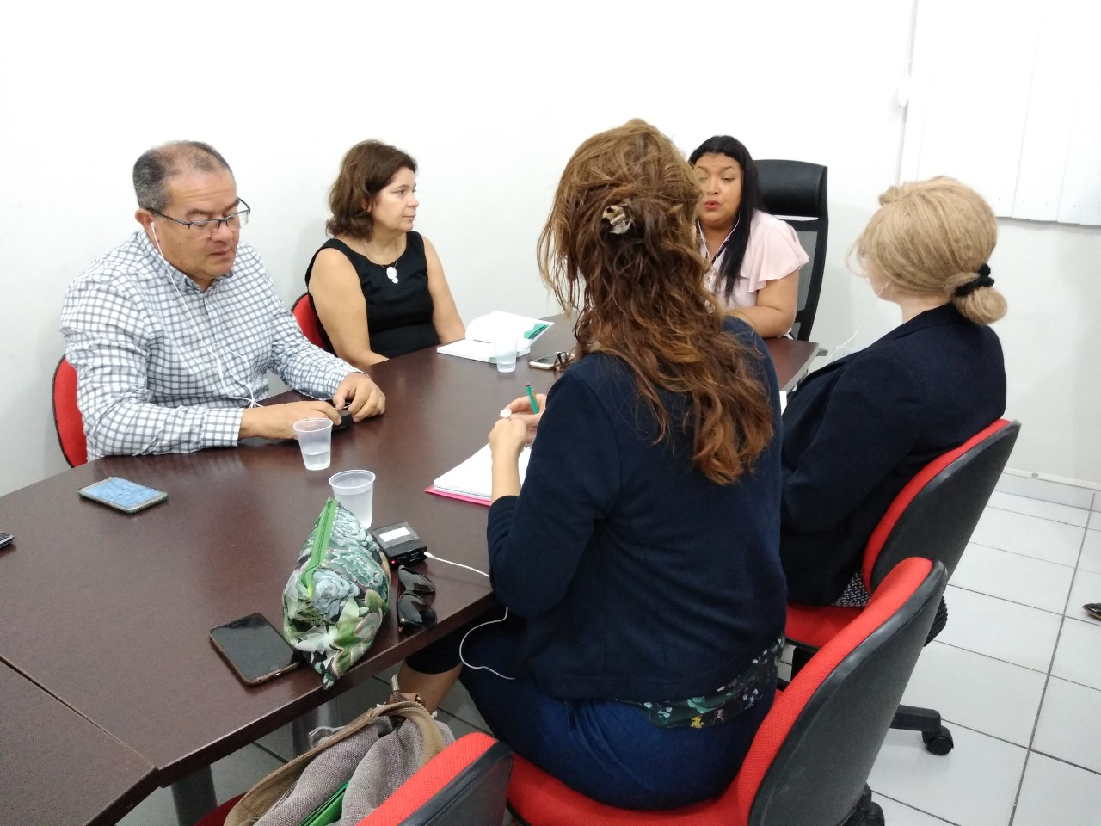
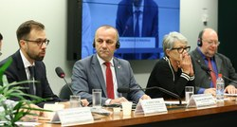
Procedimentos Especiais – visitas mais recentes
Relatora da ONU para a eliminação da discriminação das pessoas com hanseníase, Alice Cruz
Especialista independente para tratar dos direitos humanos das pessoas com albinismo, Ikponwosa Ero
Relator da ONU sobre resíduos tóxicos, Baskut Tuncak
https://www.ohchr.org/Documents/Issues/ToxicWaste/A_HRC_45_12_Add2_AUV.docx
https://www.ohchr.org/Documents/Issues/ToxicWaste/A_HRC_45_12_Add4_PT.docx
Notes:
https://news.un.org/pt/story/2020/10/1730372
http://www.mulheredireitoshumanos.al.gov.br/noticia/item/2174-especialista-em-albinismo-da-onu-visita-secretaria-de-estado-da-mulher-e-dos-direitos-humanos
https://www2.camara.leg.br/atividade-legislativa/comissoes/comissoes-permanentes/cdhm/noticias/relator-da-onu-sobre-residuos-toxicos-baskut-tuncak-apresenta-relatorio-sobre-missao-realizada-ao-brasil-em-2019#:~:text=%C3%89%20o%20que%20diz%2C%20Baskut,do%20governo%20brasileiro%20nessas%20%C3%A1reas.&text=O%20relat%C3%B3rio%20ser%C3%A1%20debatido%20amanh%C3%A3,de%20Direitos%20Humanos%20da%20ONU

Slide 23
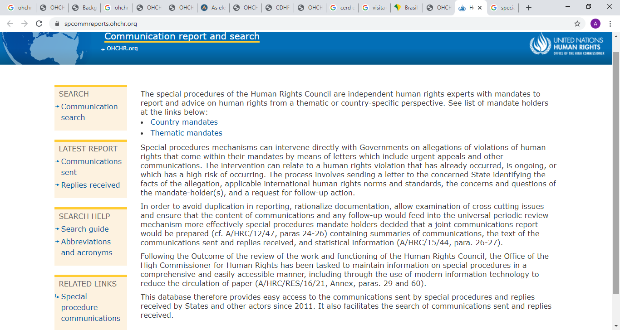
Comunicações
https://spcommreports.ohchr.org/

Slide 24
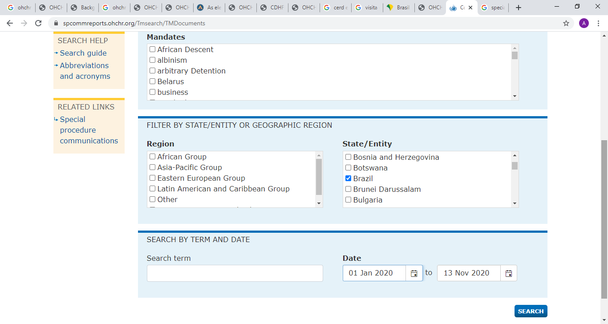
Comunicações

Slide 25
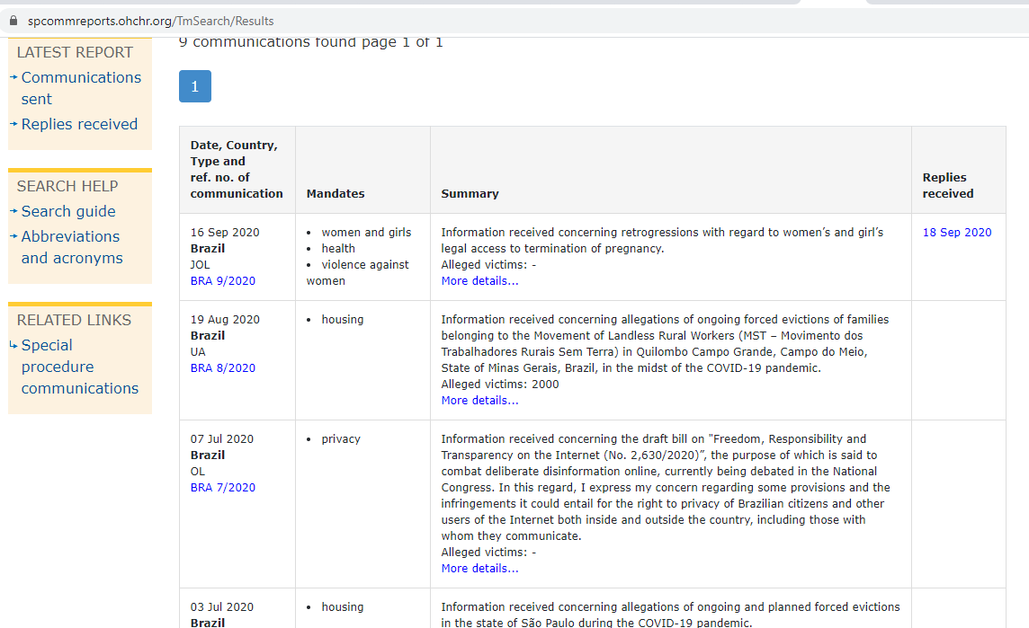
Comunicações

Slide 26
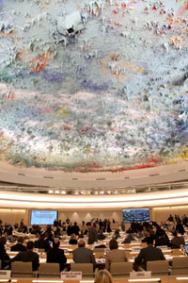
Mecanismos do HRC: Revisão Periódica Universal (RPU)
Revisão intergovernamental de pares
Cada estado é revisado em um ciclo de 4,5 anos
Comentários baseados em:
  Relatórios nacionais dos Estados sob revisão
  Relatório de coleta incluindo informações de especialistas e órgãos da ONU
  Relatório de coleta incluindo informações de outras partes interessadas (ONGs, INDHs, ...)
CDH publica um relatório com recomendações e compromissos do Estado em questão
Notes:
What is the Universal Periodic Review?
The Universal Periodic Review (UPR) is a unique process which involves a review of the human rights records of all 193 UN Member States once every 4,5 years. The UPR is a significant innovation of the Human Rights Council which is based on equal treatment for all countries. It provides an opportunity for all States to declare what actions they have taken to improve the human rights situations in their countries and to overcome challenges to the enjoyment of human rights. The UPR also includes a sharing of best human rights practices around the globe. Currently, no other mechanism of this kind exists.
How was the UPR established?
The UPR was established when the Human Rights Council was created on 15 March 2006 by the UN General Assembly in resolution 60/251. This mandated the Council to "undertake a universal periodic review, based on objective and reliable information, of the fulfilment by each State of its human rights obligations and commitments in a manner which ensures universality of coverage and equal treatment with respect to all States”. On 18 June 2007, one year after its first meeting, members of the new Council agreed to its institution-building package (A/HRC/RES/5/1) providing a road map guiding the future work of the Council. One of the key elements of this package was the new Universal Periodic Review.
What is the goal of the UPR?
The ultimate goal of UPR is the improvement of the human rights situation in every country with significant consequences for people around the globe. The UPR is designed to prompt, support, and expand the promotion and protection of human rights on the ground. To achieve this, the UPR involves assessing States’ human rights records and addressing human rights violations wherever they occur. The UPR also aims to provide technical assistance to States and enhance their capacity to deal effectively with human rights challenges and to share best practices in the field of human rights among States and other stakeholders.
Who conducts the review?
The reviews are conducted by the UPR Working Group which consists of the 47 members of the Council; however any UN Member State can take part in the discussion/dialogue with the reviewed States. Each State review is assisted by groups of three States, known as “troikas”, who serve as rapporteurs. The selection of the troikas for each State review is done through a drawing of lots prior for each Working Group session.
What are the reviews based on?
The documents on which the reviews are based are: 1) information provided by the State under review, which can take the form of a “national report”; 2) information contained in the reports of independent human rights experts and groups, known as the Special Procedures, human rights treaty bodies, and other UN entities; 3) information from other stakeholders including non-governmental organizations and national human rights institutions.
How are the reviews conducted?
Reviews take place through an interactive discussion between the State under review and other UN Member States. This takes place during a meeting of the UPR Working Group. During this discussion any UN Member State can pose questions, comments and/or make recommendations to the States under review. The troikas may group issues or questions to be shared with the State under review to ensure that the interactive dialogue takes place in a smooth and orderly manner. The duration of the review will be three hours for each country in the Working Group.
Can non-governmental organizations (NGOs) participate in the UPR process?
Yes. NGOs can submit information which can be added to the “other stakeholders” report which is considered during the review. Information they provide can be referred to by any of the States taking part in the interactive discussion during the review at the Working Group meeting. NGOs can attend the UPR Working Group sessions and can make statements at the regular session of the Human Rights Council when the outcome of the State reviews are considered. OHCHR has released "Technical guidelines for the submission of stakeholders”.
What human rights obligations are addressed?
The UPR will assess the extent to which States respect their human rights obligations set out in: (1) the UN Charter; (2) the Universal Declaration of Human Rights; (3) human rights instruments to which the State is party (human rights treaties ratified by the State concerned); (4) voluntary pledges and commitments made by the State (e.g. national human rights policies and/or programmes implemented); and, (5) applicable international humanitarian law.
What is the outcome of the review?
Following the State review by the Working Group a report is prepared by the troika with the involvement of the State under review and assistance from the OHCHR. This report, referred to as the “outcome report”, provides a summary of the actual discussion. It therefore consists of the questions, comments and recommendations made by States to the country under review, as well as the responses by the reviewed State.
How is the review adopted?
During the Working Group session half an hour is allocated to adopt each of the “outcome reports” for the States reviewed that session. These take place no sooner than 48 hours after the country review. The reviewed State has the opportunity to make preliminary comments on the recommendations choosing to either accept or reject them. Both accepted and refused recommendations are included in the report. After the report has been adopted, editorial modifications can be made to the report by States on their own statements, within the following two weeks. The report then has to be adopted at a plenary session of the Human Rights Council. During the plenary session, the State under review can reply to questions and issues that were not sufficiently addressed during the Working Group and respond to recommendations that were raised by States during the review. Time is also allotted to member and observer States who may wish to express their opinion on the outcome of the review and for NGOs and other stakeholders to make general comments.
What steps are taken as follow up to the review?
The State has the primary responsibility to implement the recommendations contained in the final outcome. The UPR ensures that all countries are accountable for progress or failure in implementing these recommendations. When it comes time for the second review of a State they must provide information on what they have been doing to implement the recommendations made during the 1st review four year’s earlier. The international community will assist in implementing the recommendations and conclusions regarding capacity-building and technical assistance, in consultation with the country concerned. If necessary, the Council will address cases where States are not cooperating.
What happens if a State is not cooperating with the UPR?
The Human Rights Council will decide on the measures it would need to take in case of persistent non-cooperation by a State with the UPR.

Slide 27
RESUMO: Diferentes funções dos mecanismos de direitos humanos
 | Tipo | Mandato | Funciones
RPU | Intergovernamental | Conselho de Direitos Humanos | - Relatório
PEs | Especialistas | Conselho de Direitos Humanos | - Visitas - Reclamações individuais
OTs | Especialistas | Nove principais tratados sobre direitos humanos | - Relatório - Reclamações individuais - Visitas (para 1 OT-PEs)
 | OS TRÊS MECANISMOS EMITEM RECOMENDAÇÕES !!
Notes:
Explain all HRMs and their functions and that during this workshop focus will be given to engagement with HRM regarding reporting. Mention that the reporting cycle is going to be explained in the next session as well as the perioridicity of reporting.

Slide 28
Obrigada!
Angela Pires Terto, Assessora de Direitos Humanos, ONU Brasil (angela.pires@one.un.org / apires@ohchr.org
www.ohchr.org – www.acnudh.org

